Slide 1
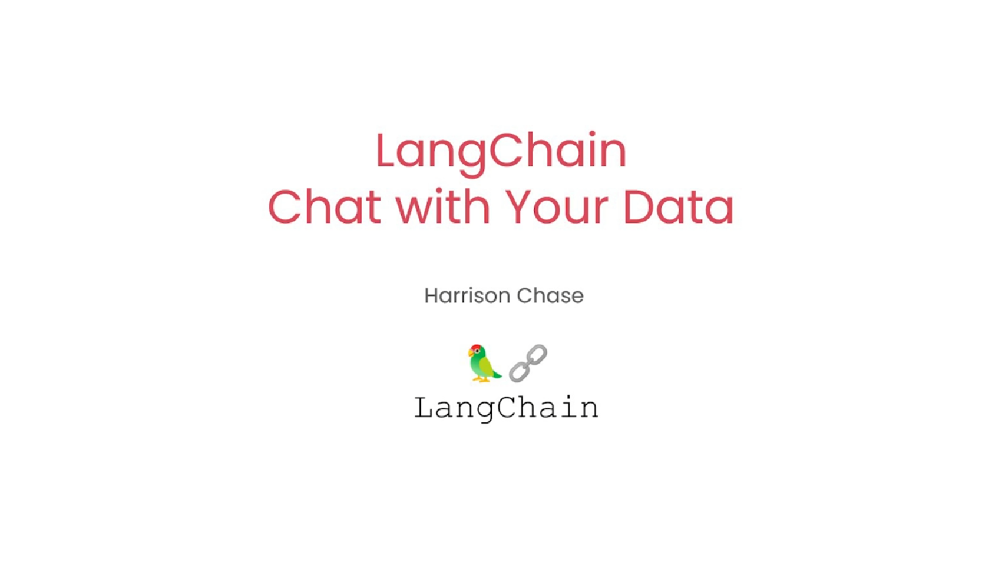

Slide 2
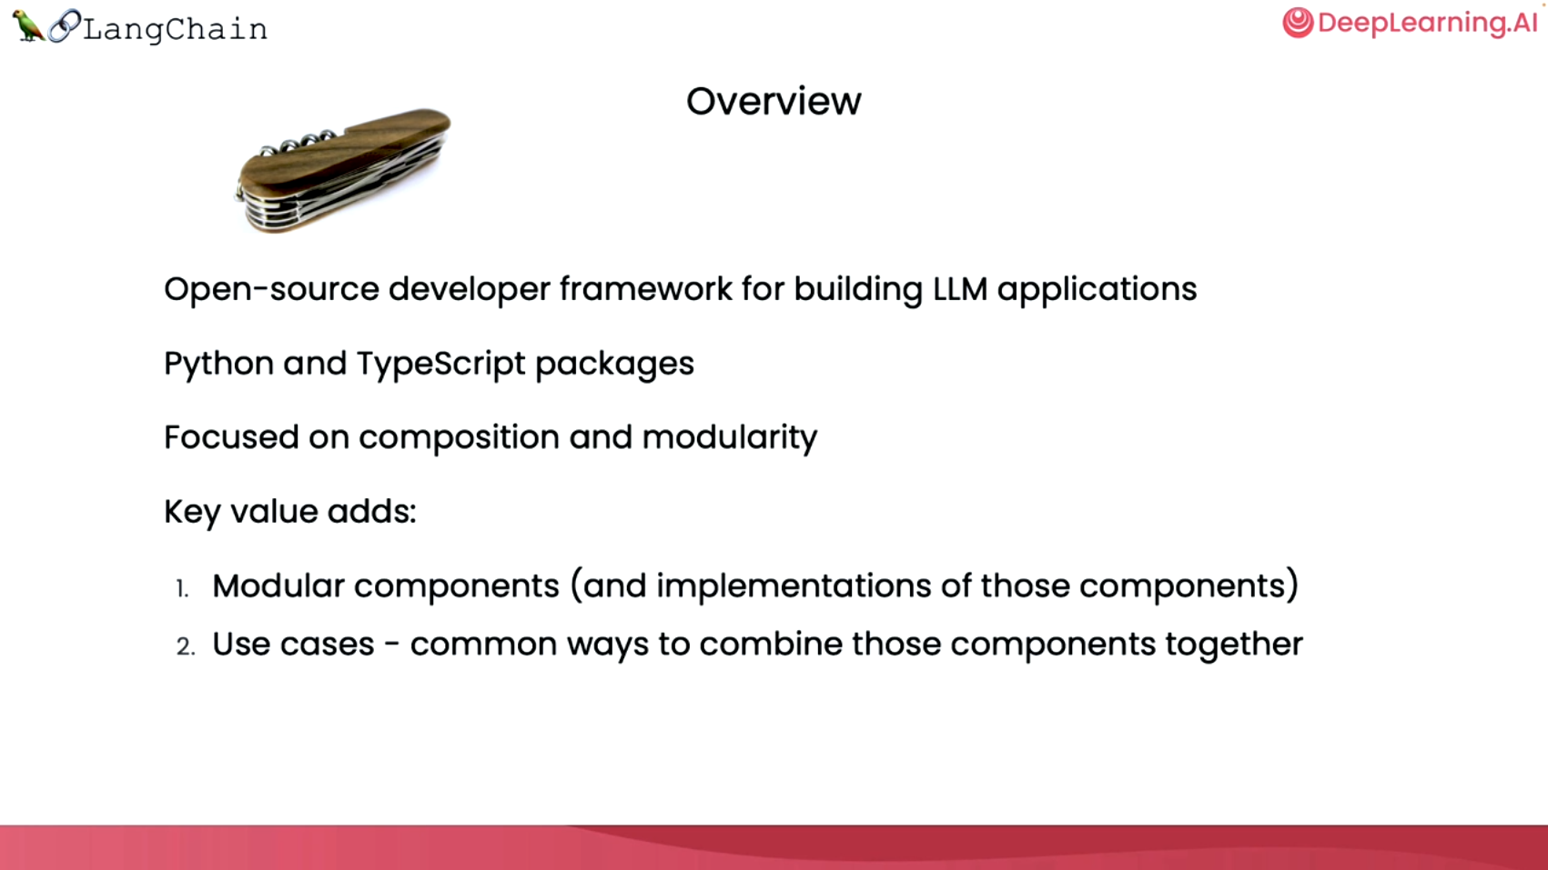

Slide 3
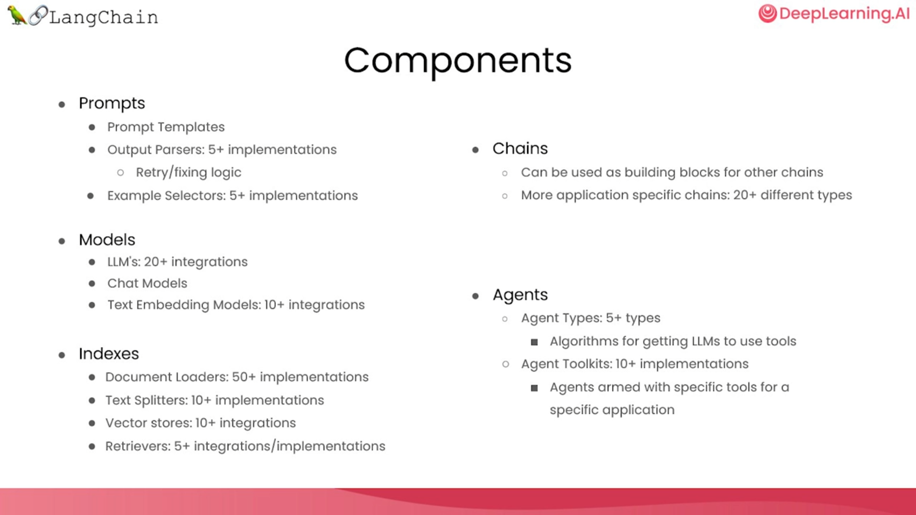

Slide 4
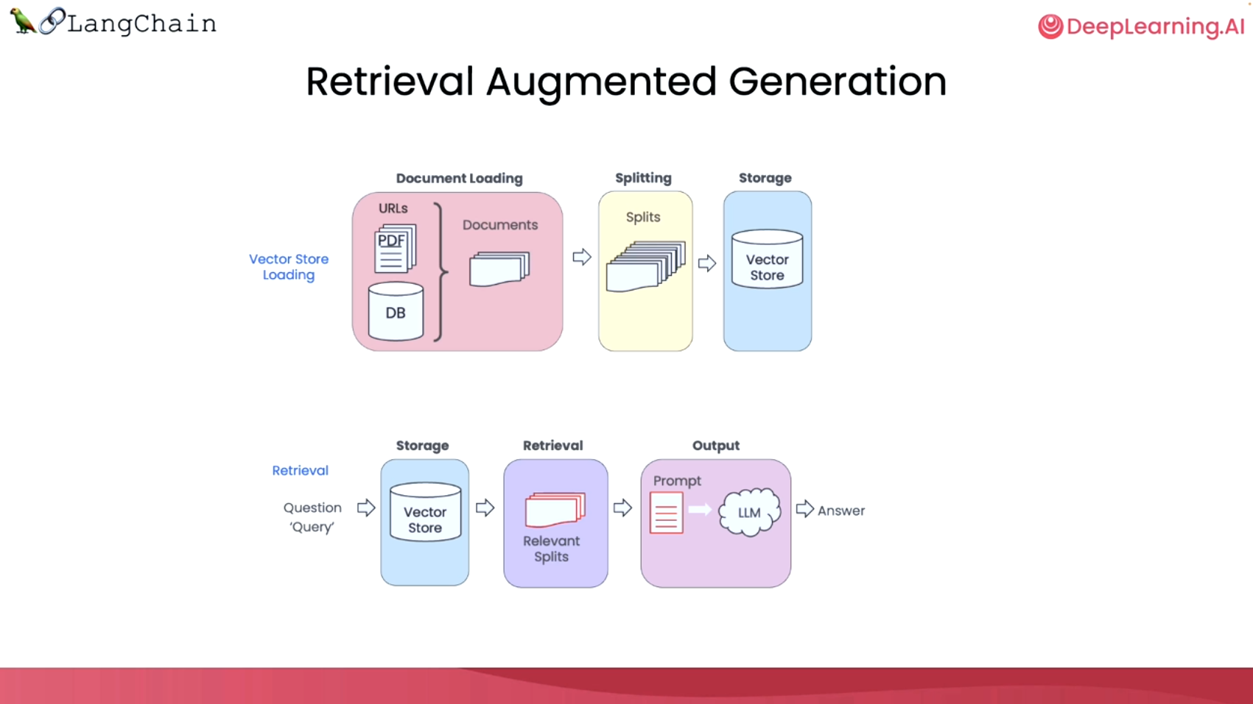

Slide 5
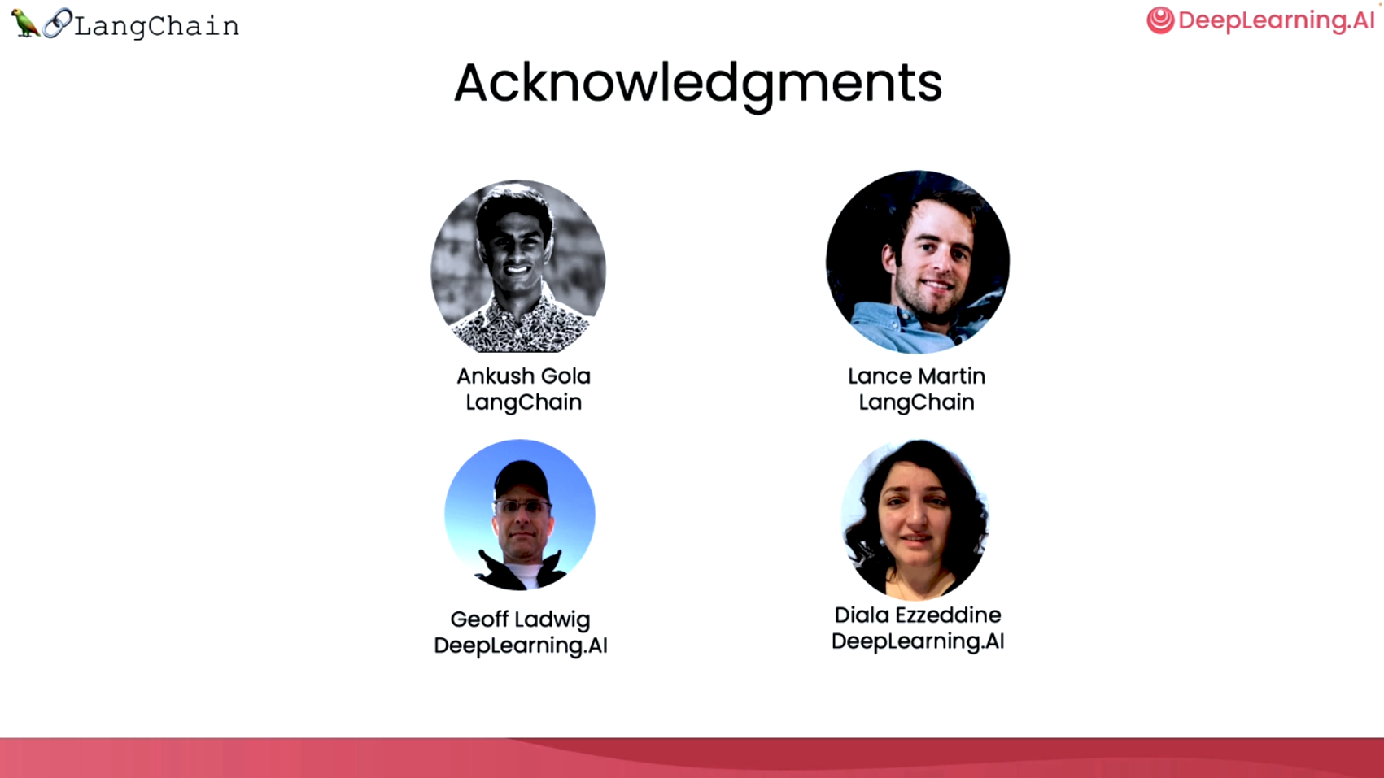

Slide 6
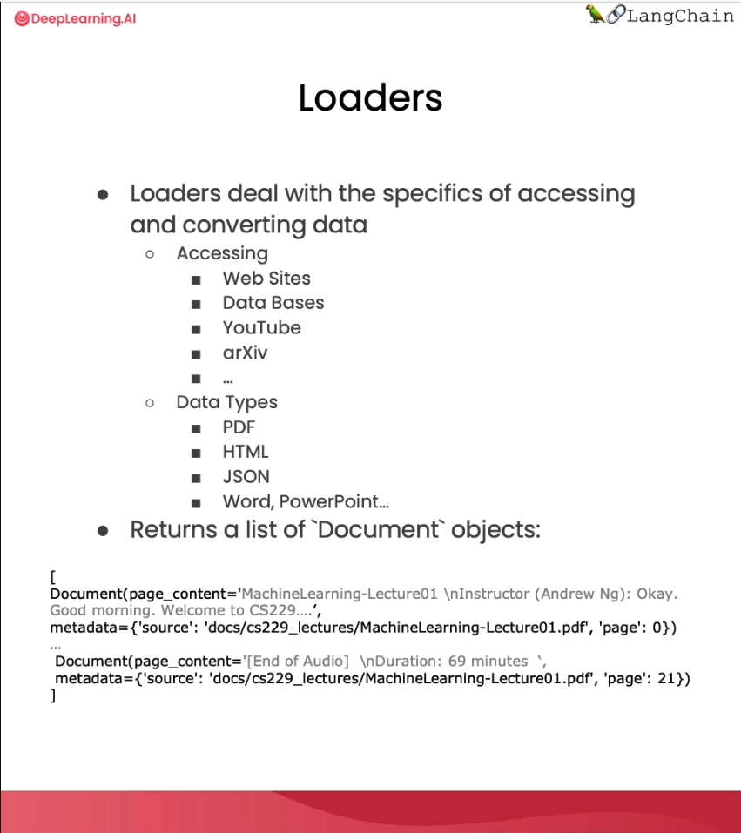
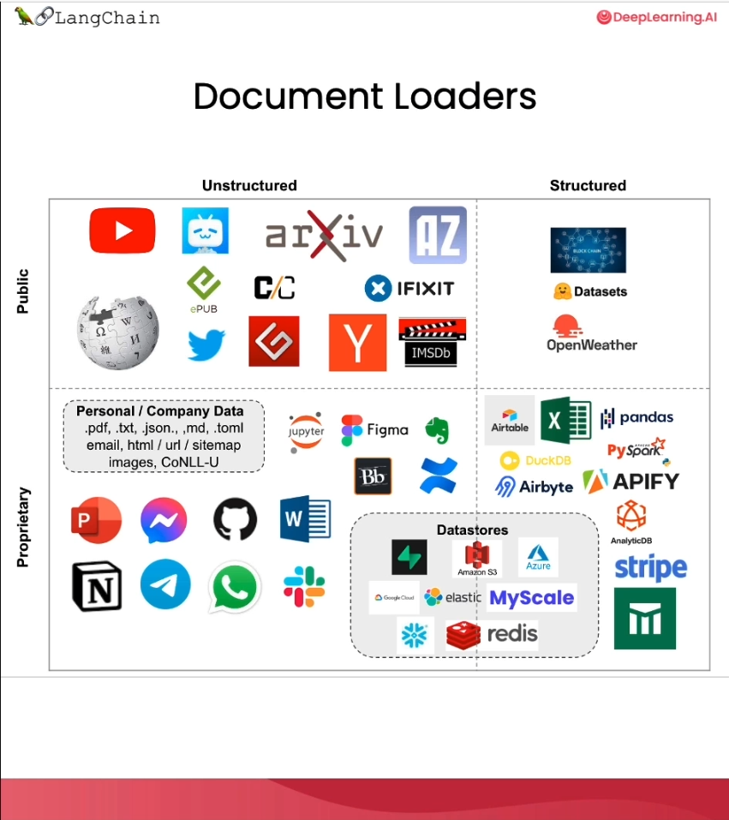

Slide 7
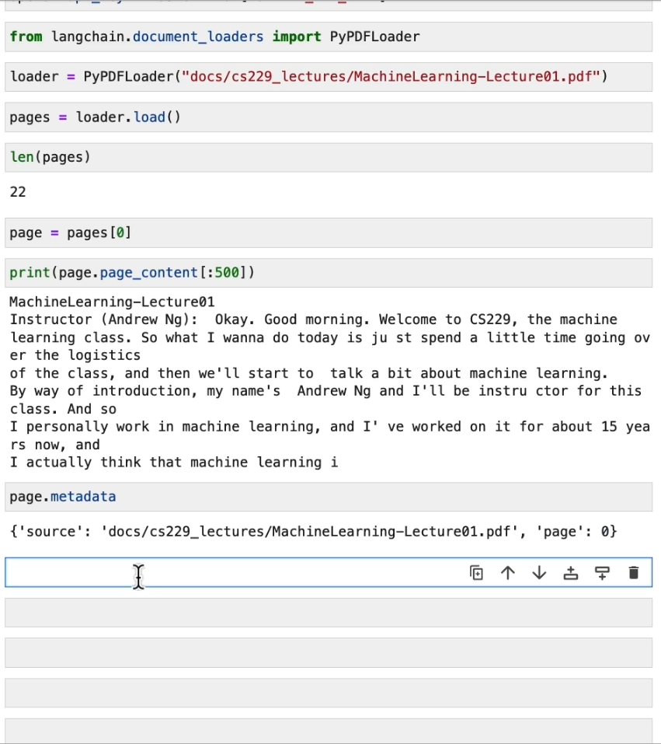
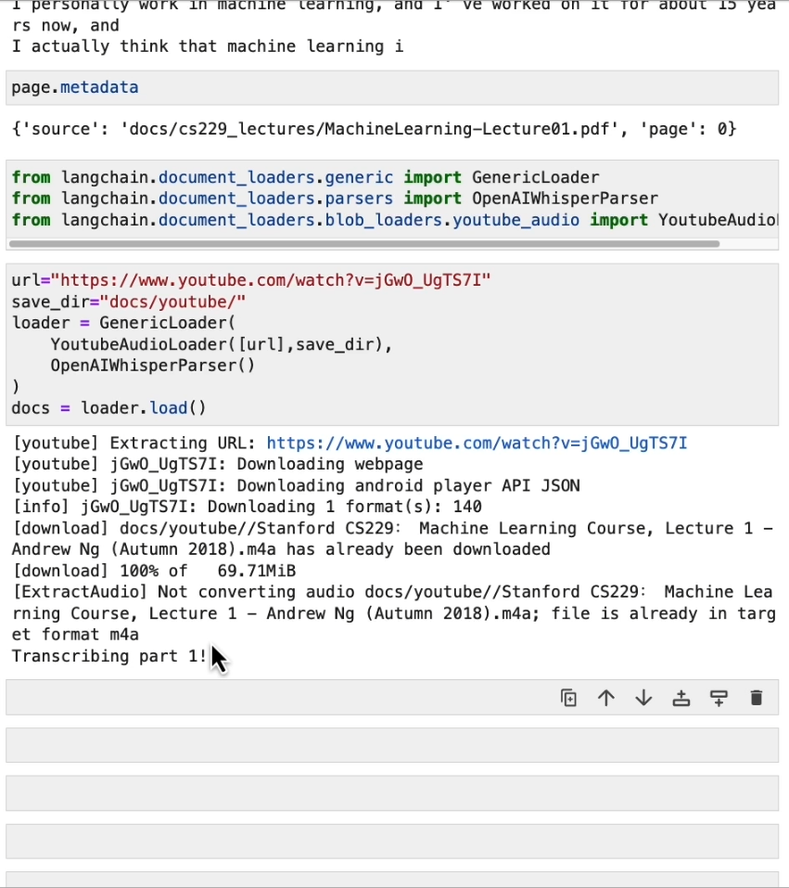

Slide 8
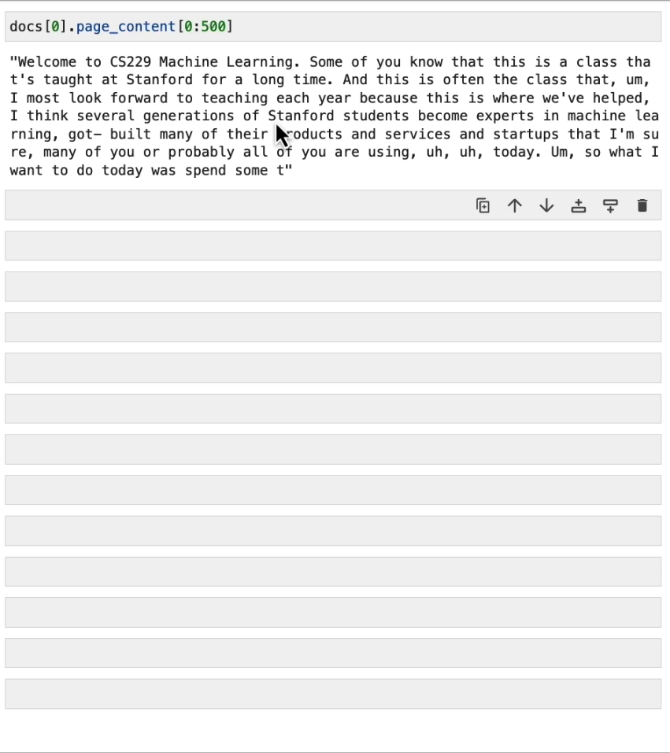
Transcript is done via OpenAI Whisper https://openai.com/research/whisper
Whisper is an automatic speech recognition (ASR) system trained on 680,000 hours of multilingual and multitask supervised data collected from the web. We show that the use of such a large and diverse dataset leads to improved robustness to accents, background noise and technical language. Moreover, it enables transcription in multiple languages, as well as translation from those languages into English. We are open-sourcing models and inference code to serve as a foundation for building useful applications and for further research on robust speech processing.
Run it localy:
https://www.youtube.com/watch?v=U2TqRKjw1-k

Slide 9
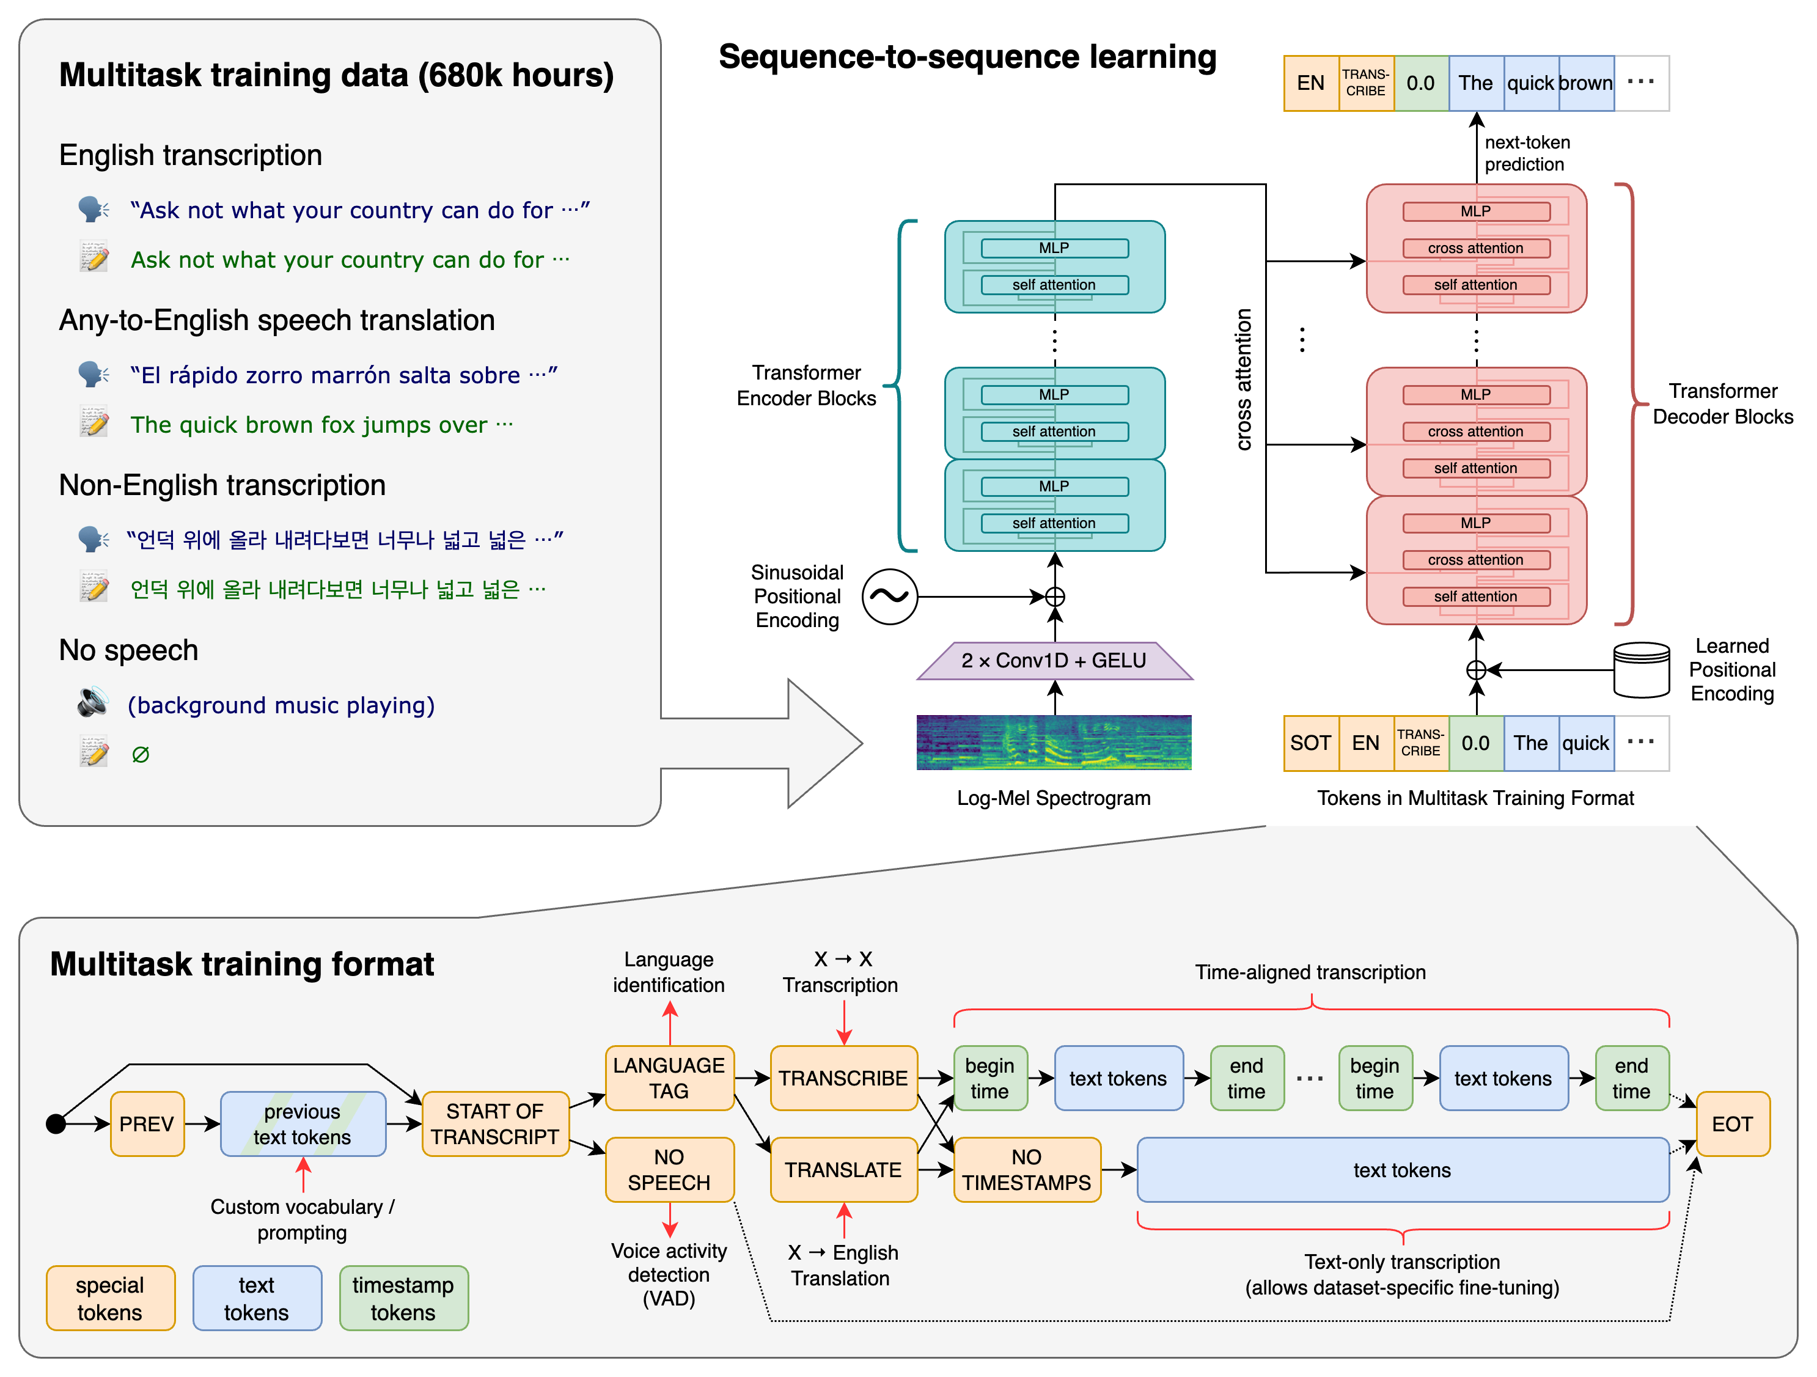

Slide 10
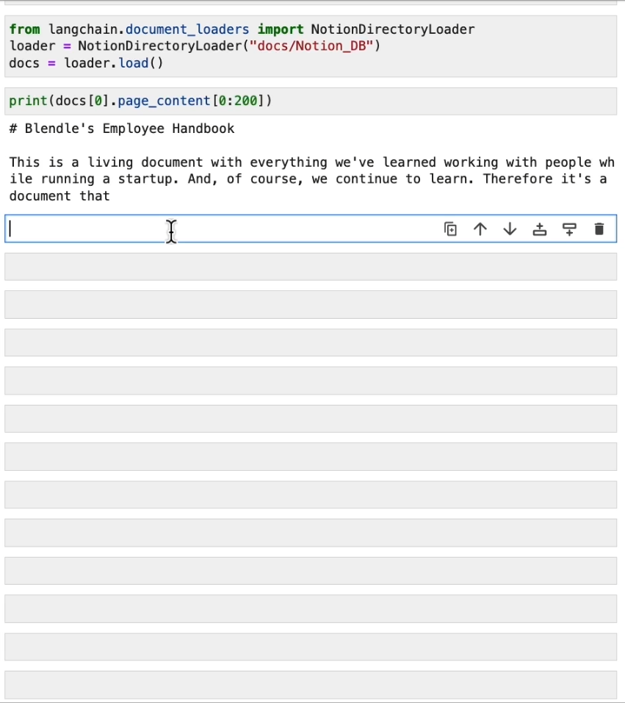

Slide 11
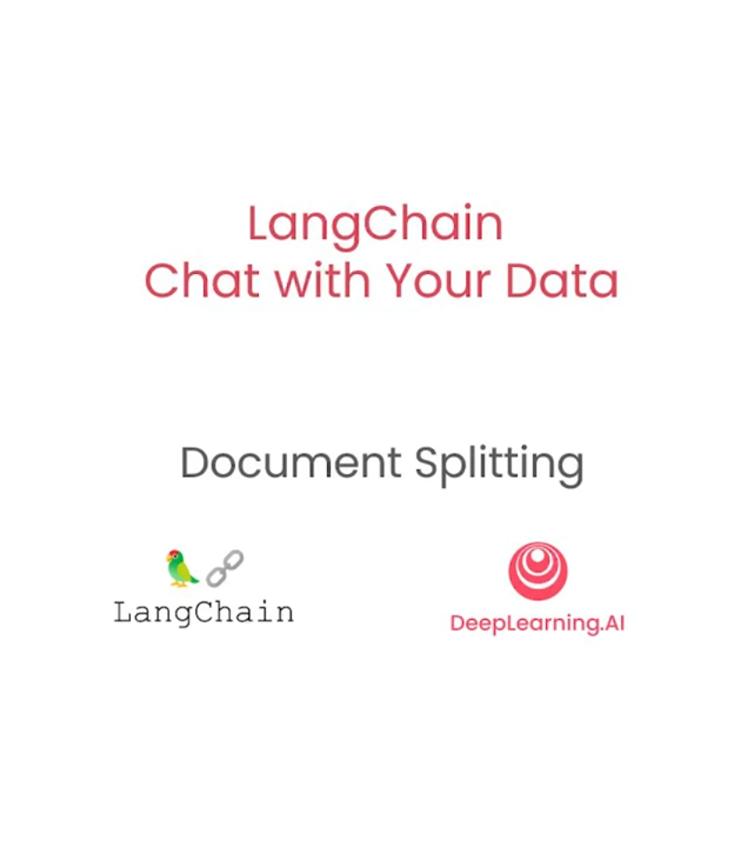

Slide 12
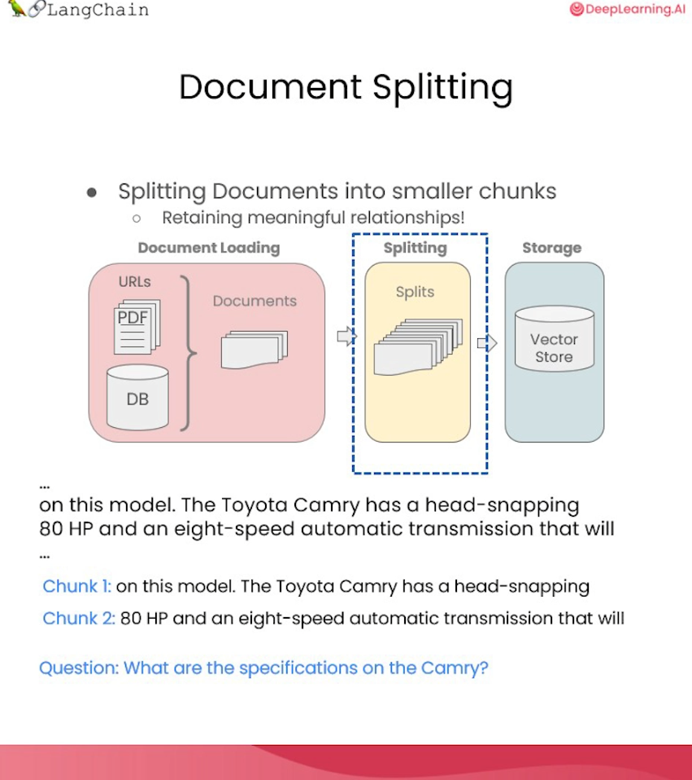
It’s tricky to split and not to end with sentance spliting to get full information.
Sometime its splitting with chung size and overlapping

Slide 13
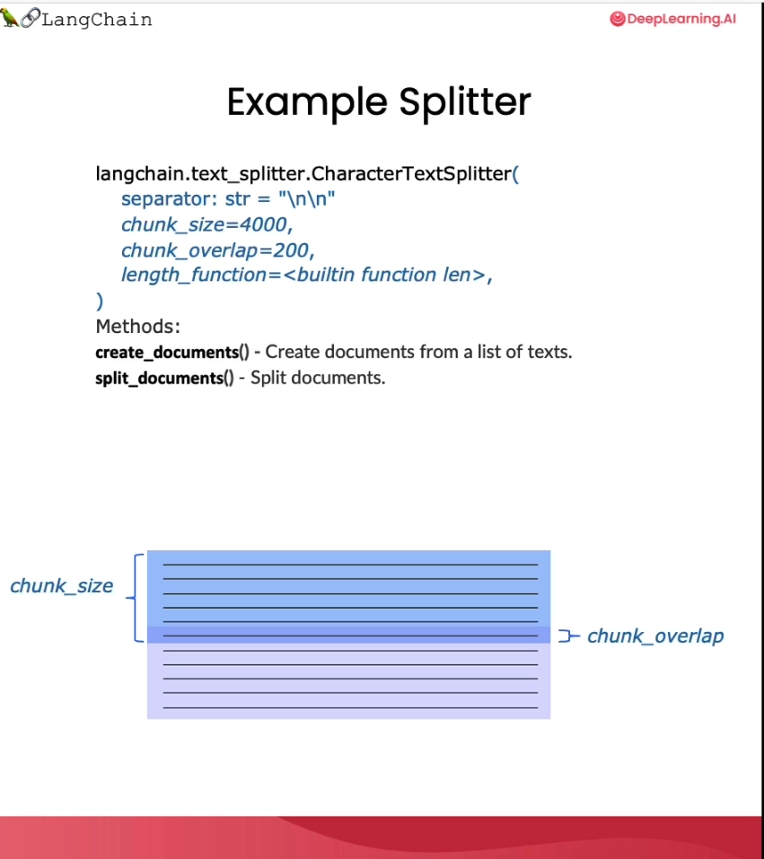
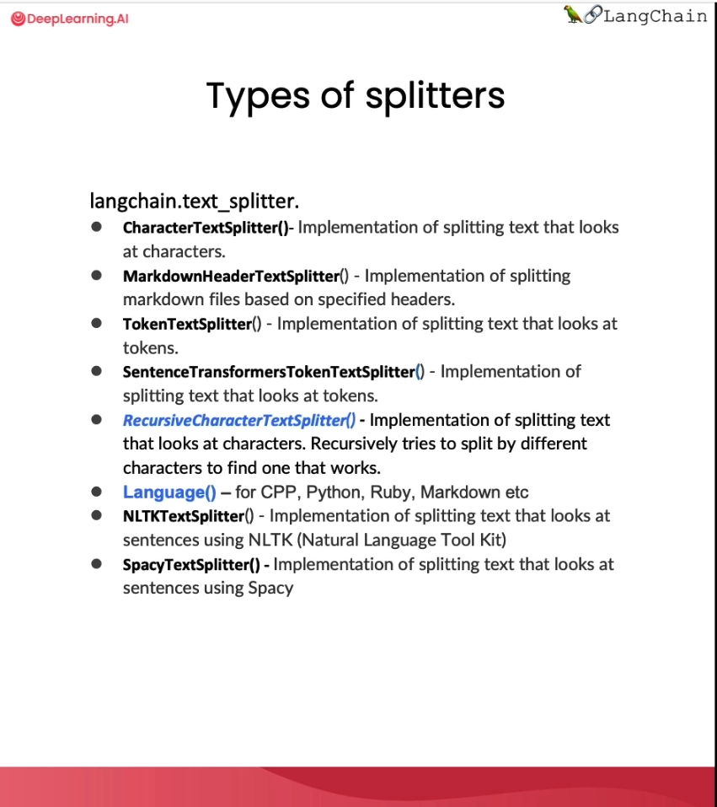

Slide 14
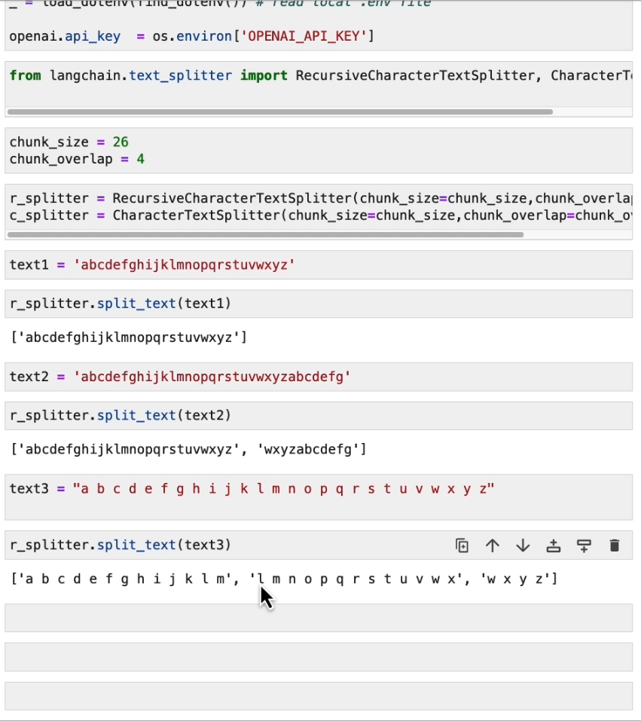
Splitting characters by position, can be empty - space
There are 3 chunks with overlaping characters like „l m” , „ w x”

Slide 15
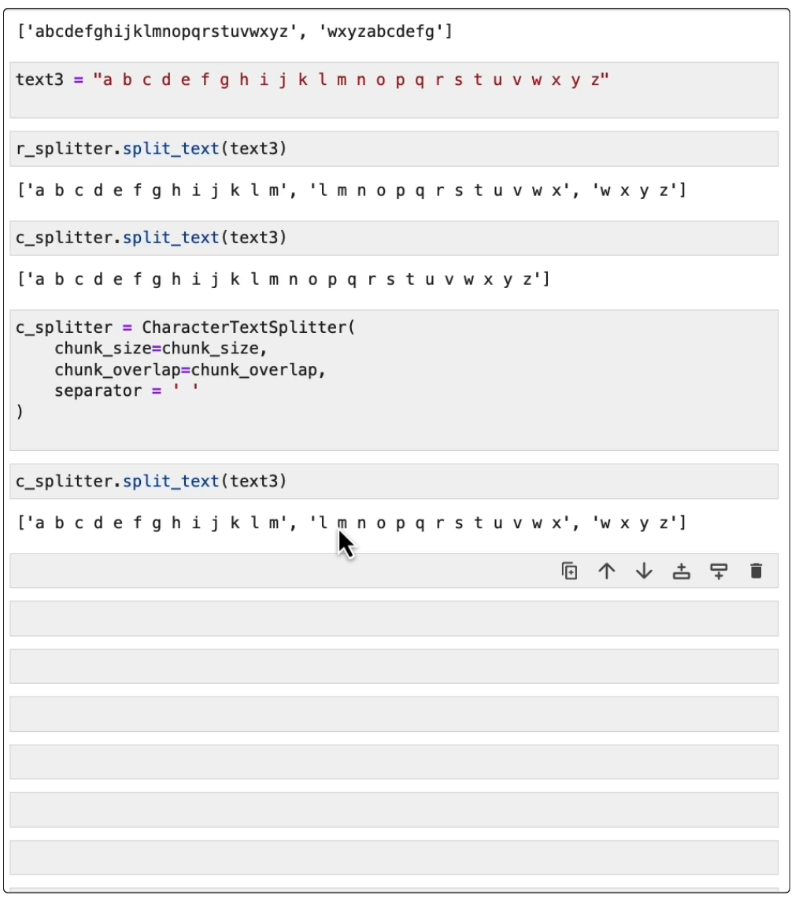
Splitting characters, can be empty - space
Splitting characters, separator can be empty space, so there is no empty space in from or end of a chunk

Slide 16
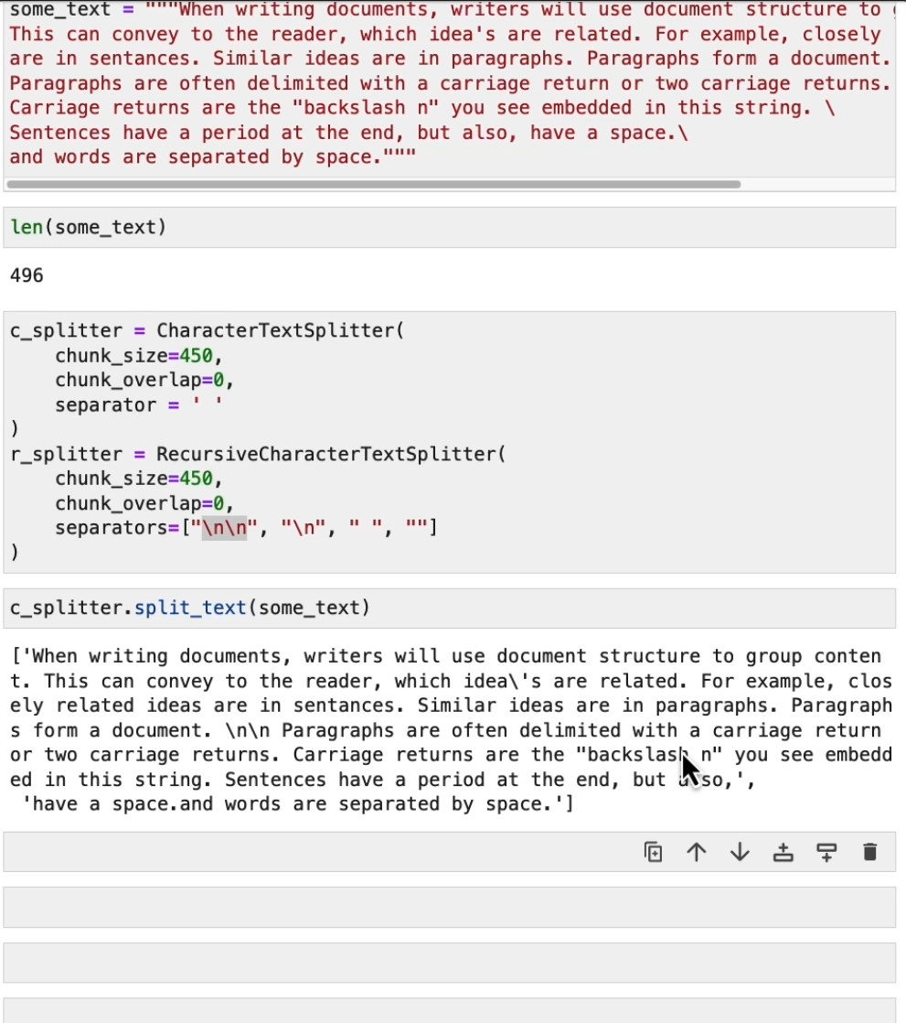


Recursive splitter first splits by “\n\n” and if it needs further to split then in does it with “\n” and further with “ “..
It splits with the “ “ and creates

Slide 17
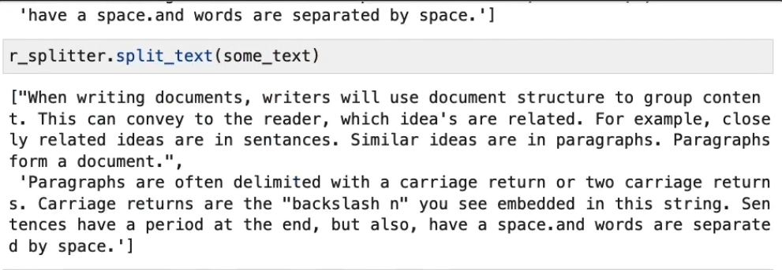
Recursive splitter first splits by “\n\n” and if it needs further to split then in does it with “\n” and further with “ “.. It’s properly splitted in two chunks just before 450 characters.

Slide 18
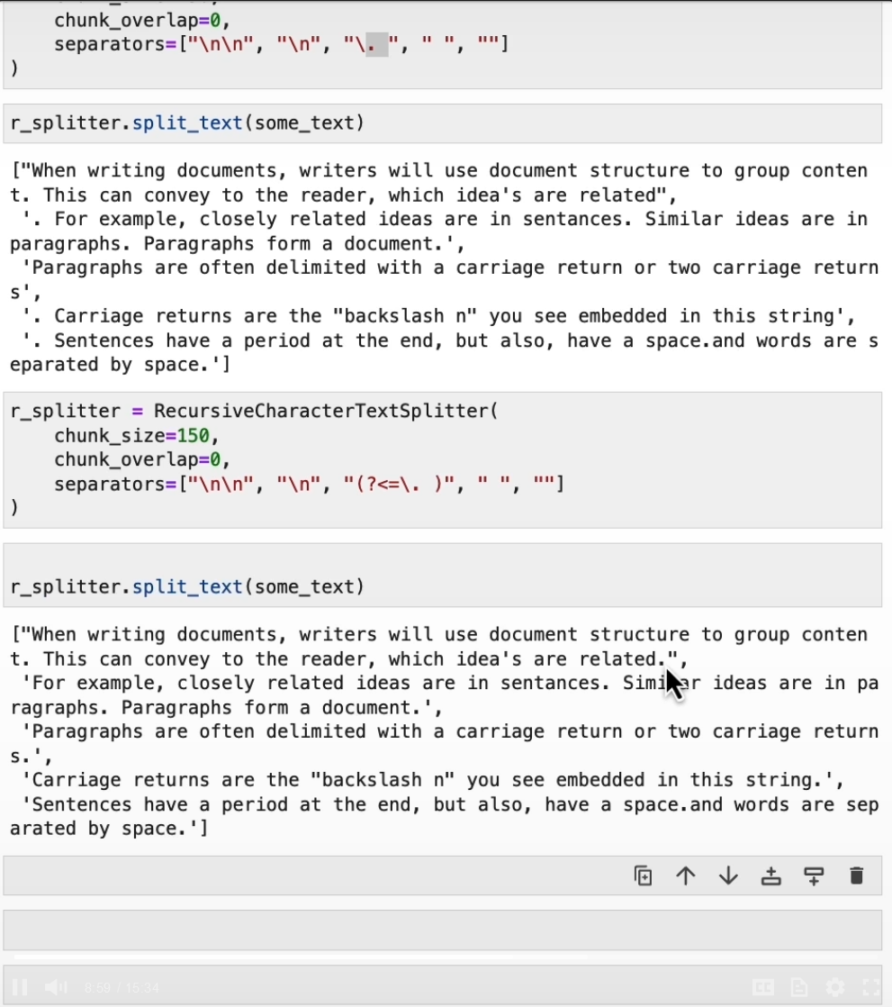


Not properly splited with the “. “
With regex separator sentences are properly splitted.

Slide 19
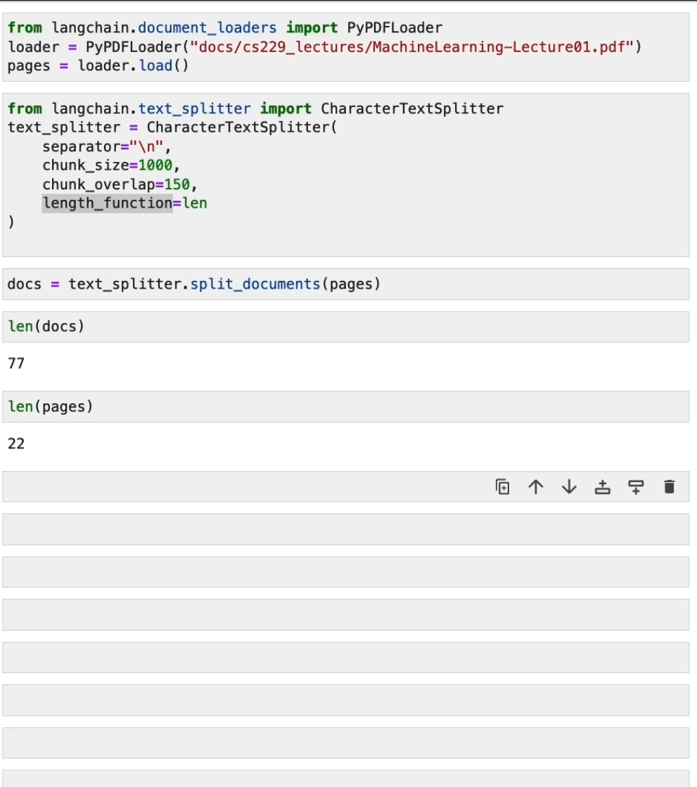
Splitting PDF documents
Using method split_documents for PDFs

Slide 20
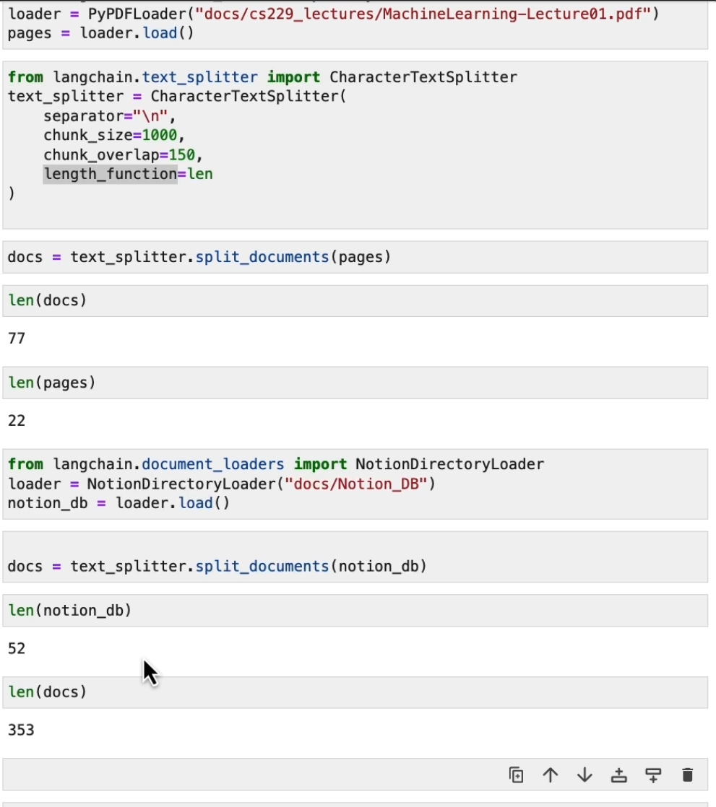
Using method for database loading and splitting

Slide 21
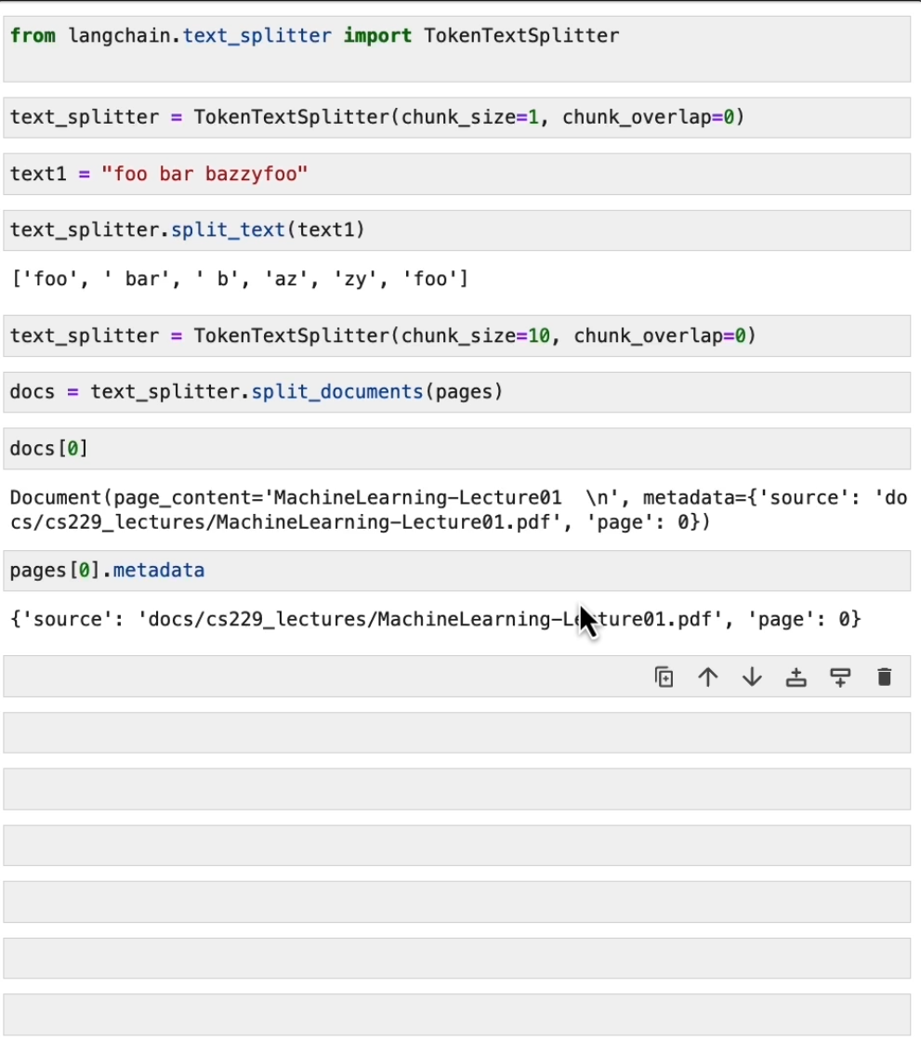
Token splitting
We can also split on token count explicity, if we want.
This can be useful because LLMs often have context windows designated in tokens.
Tokens are often ~4 characters.
Metadata of the source is preserved, so for QA we can do a reference to a document from a chunk.

Slide 22
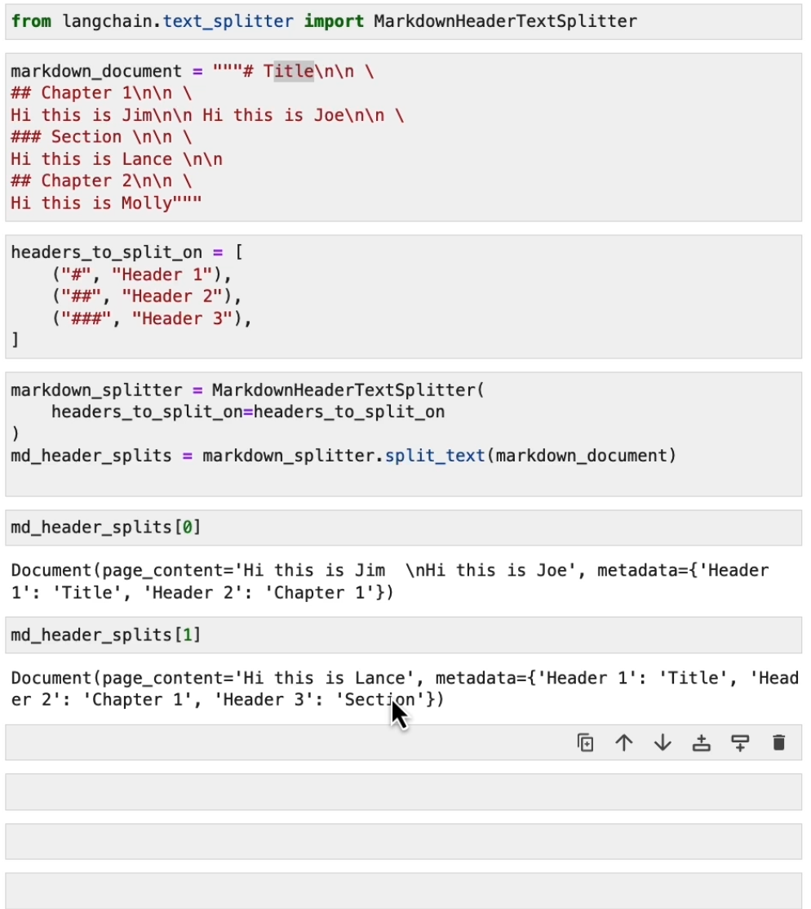

Slide 23


Slide 24
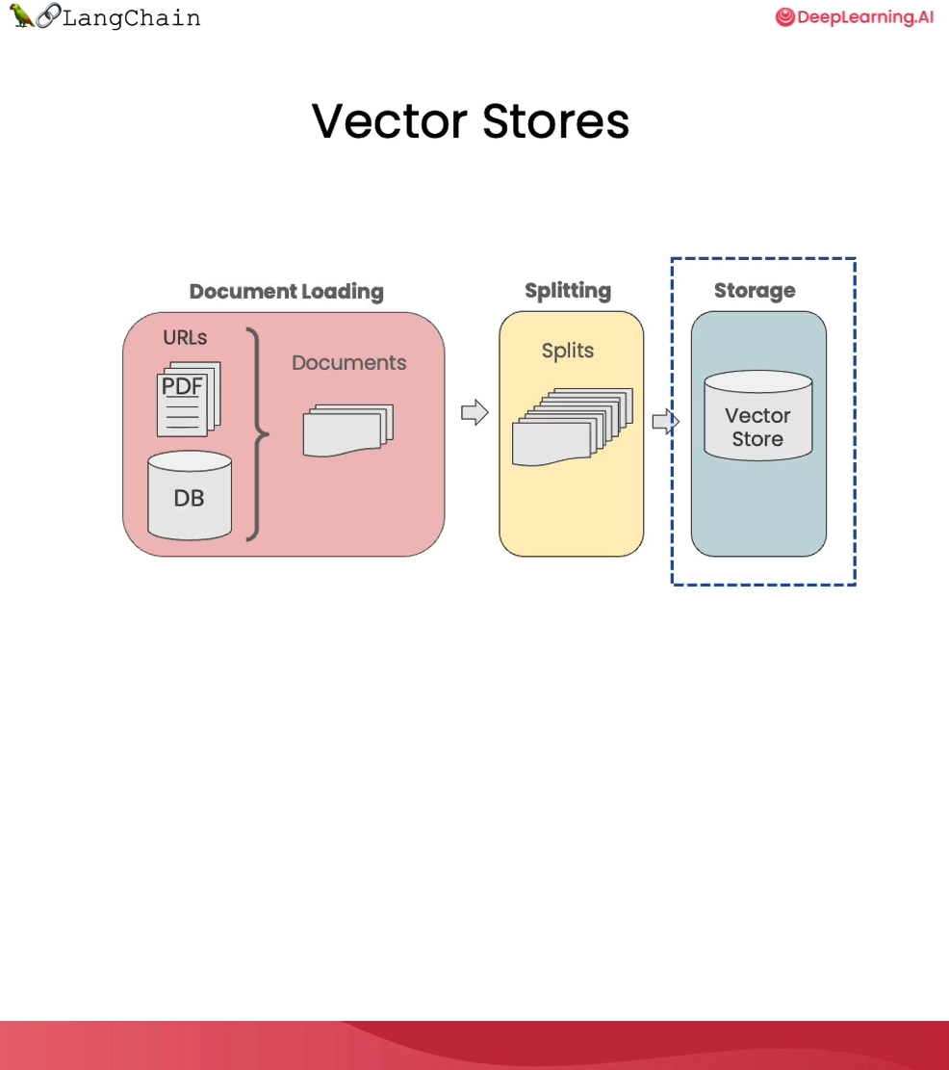
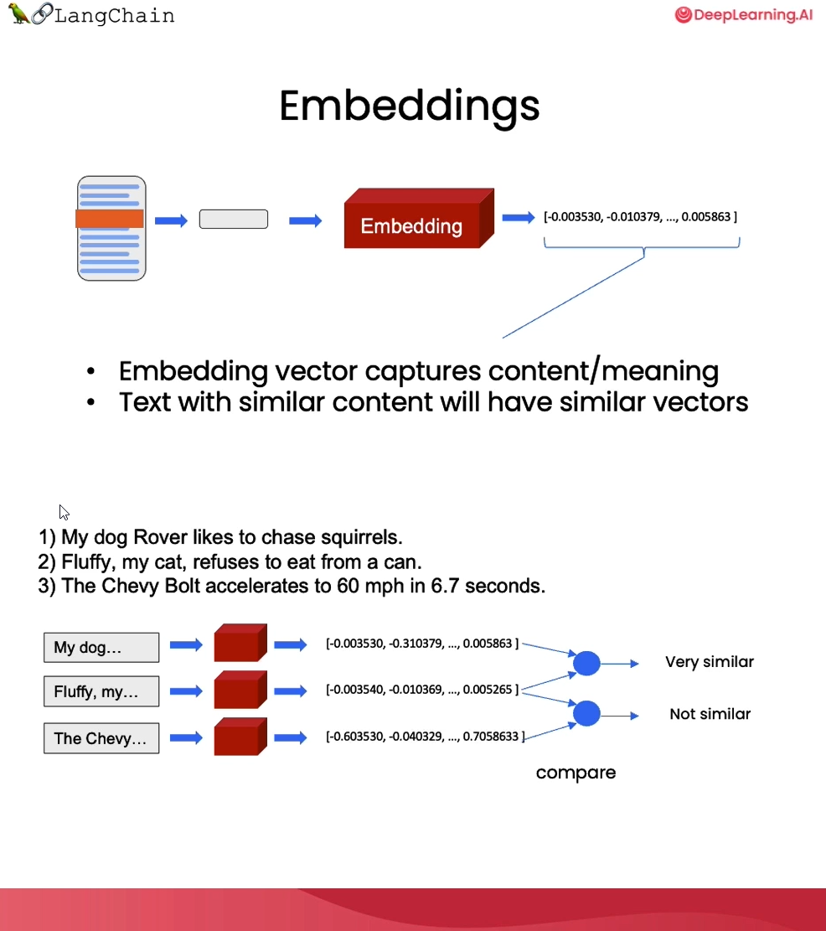

Slide 25
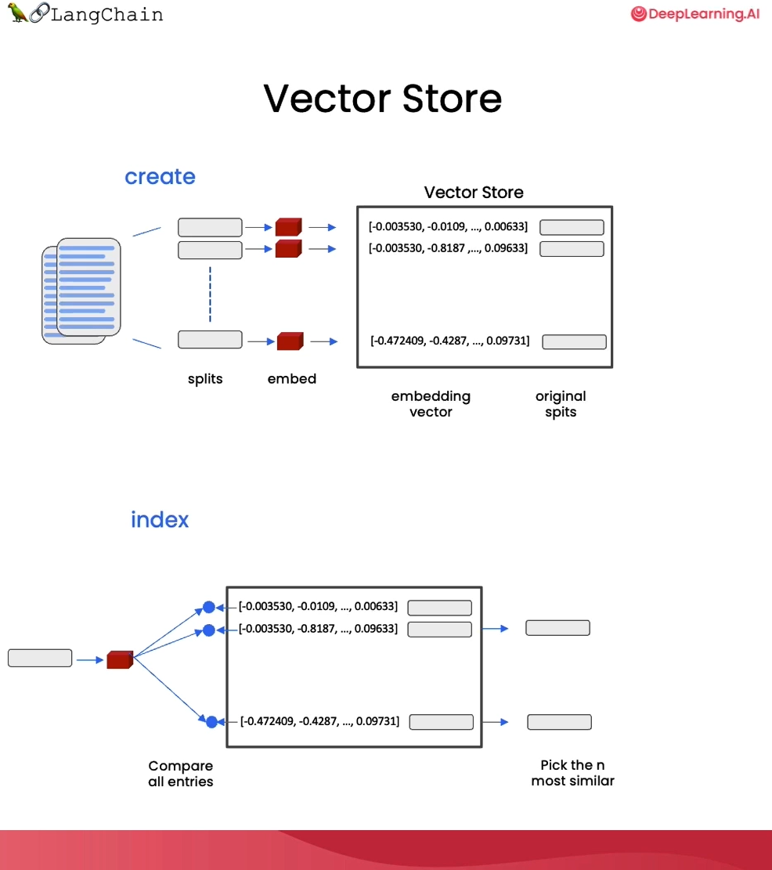
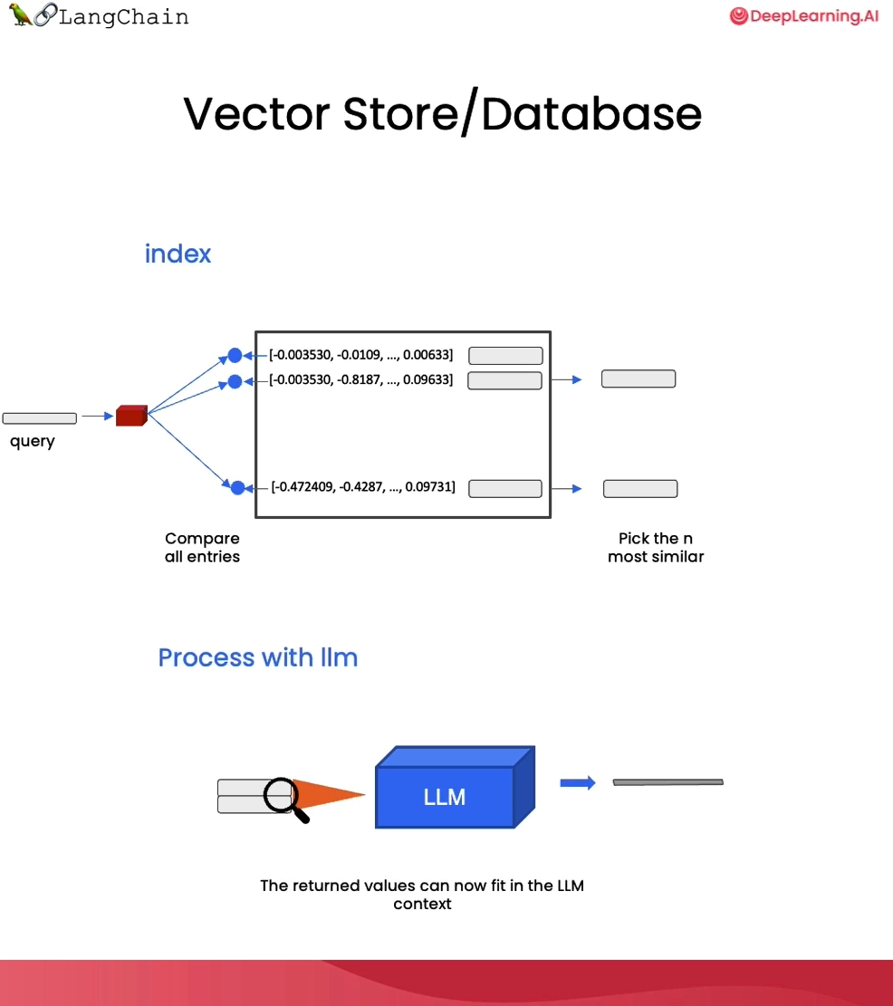

Slide 26
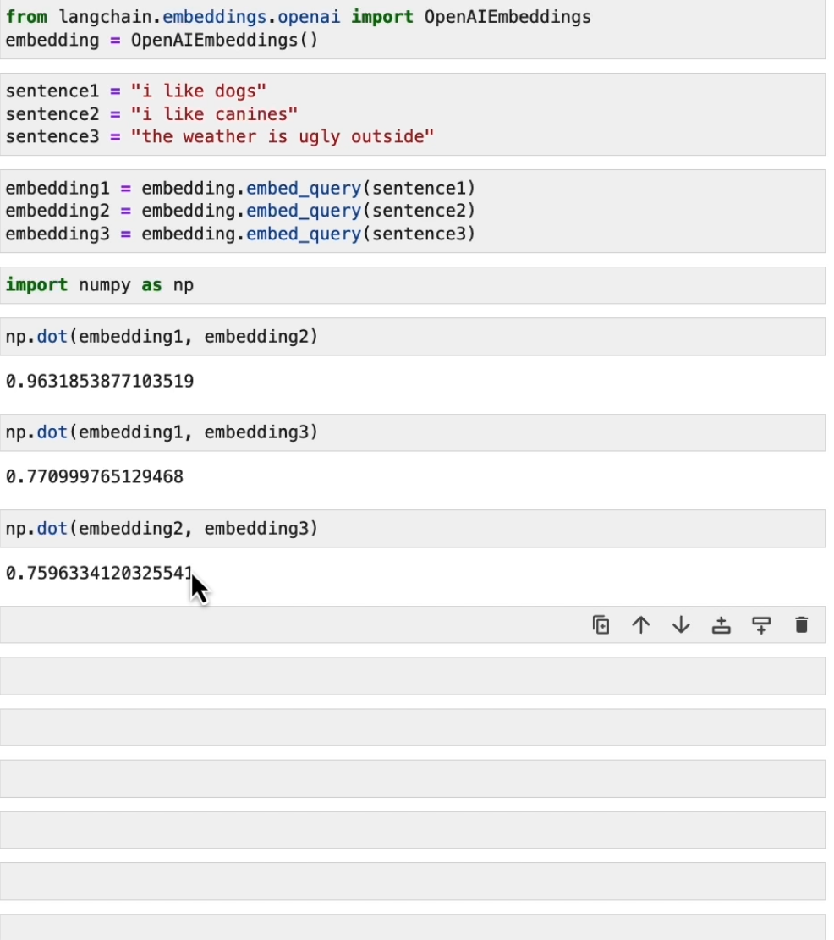
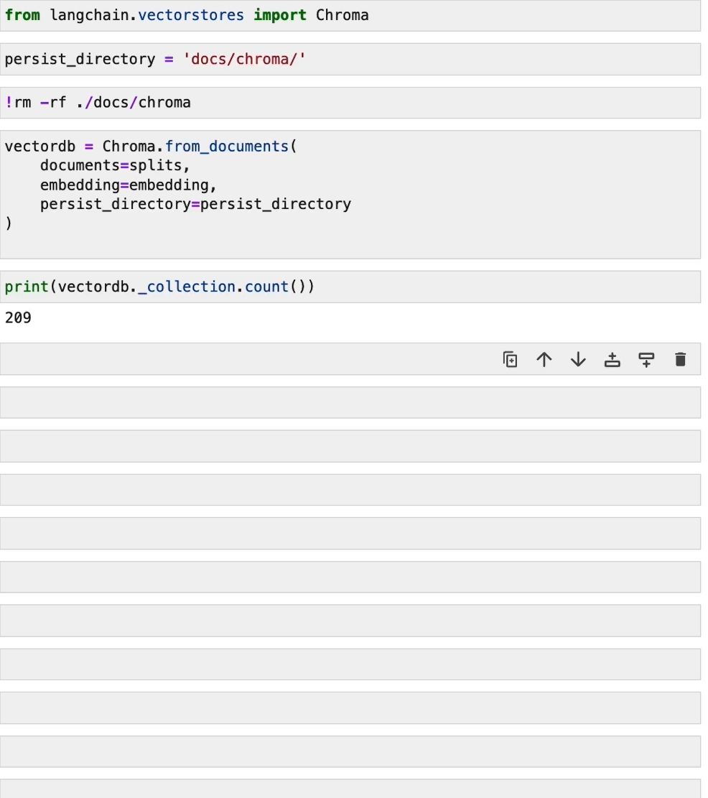

Slide 27
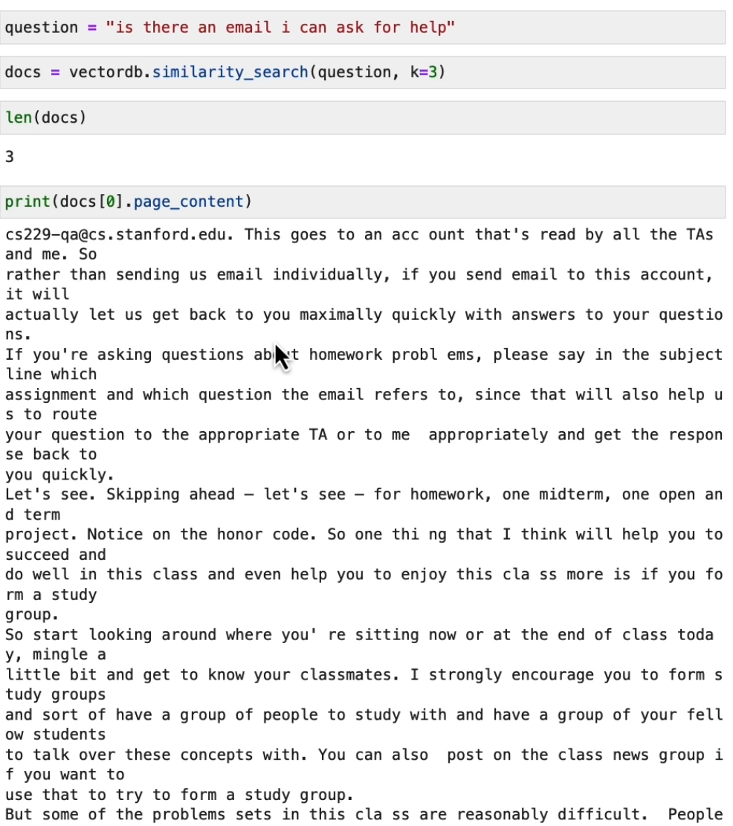
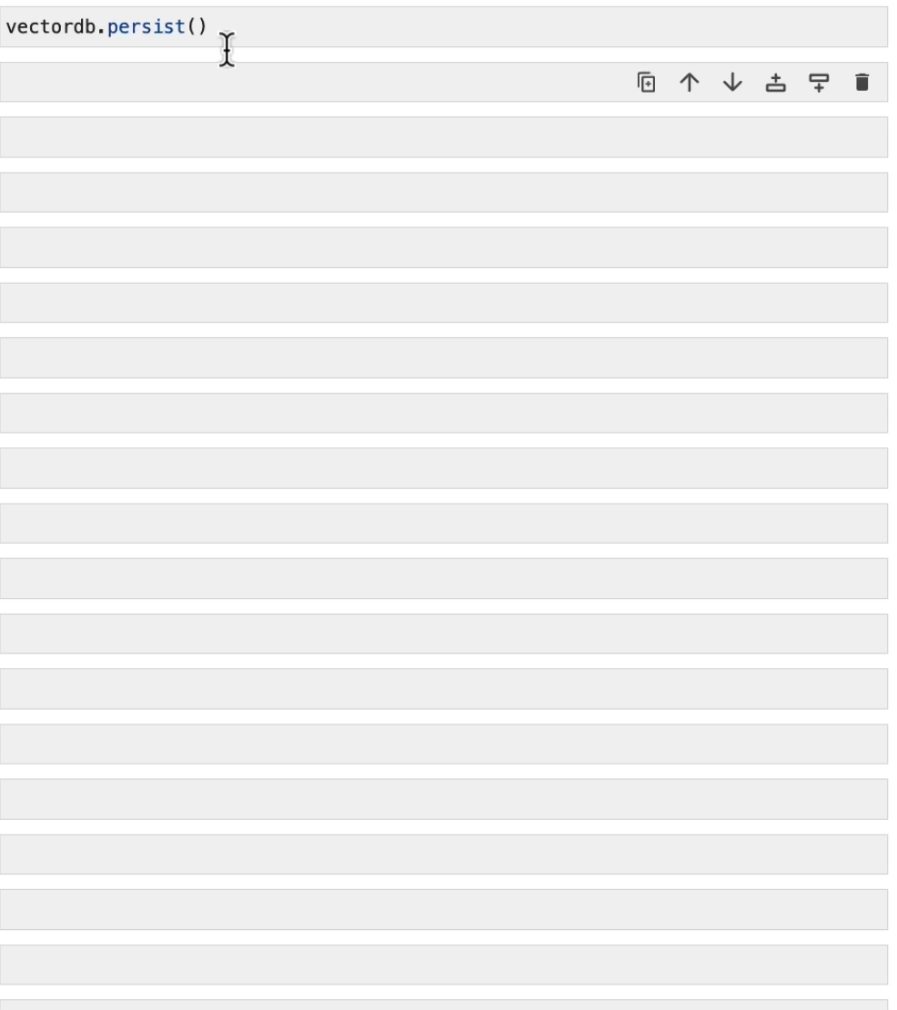

Slide 28
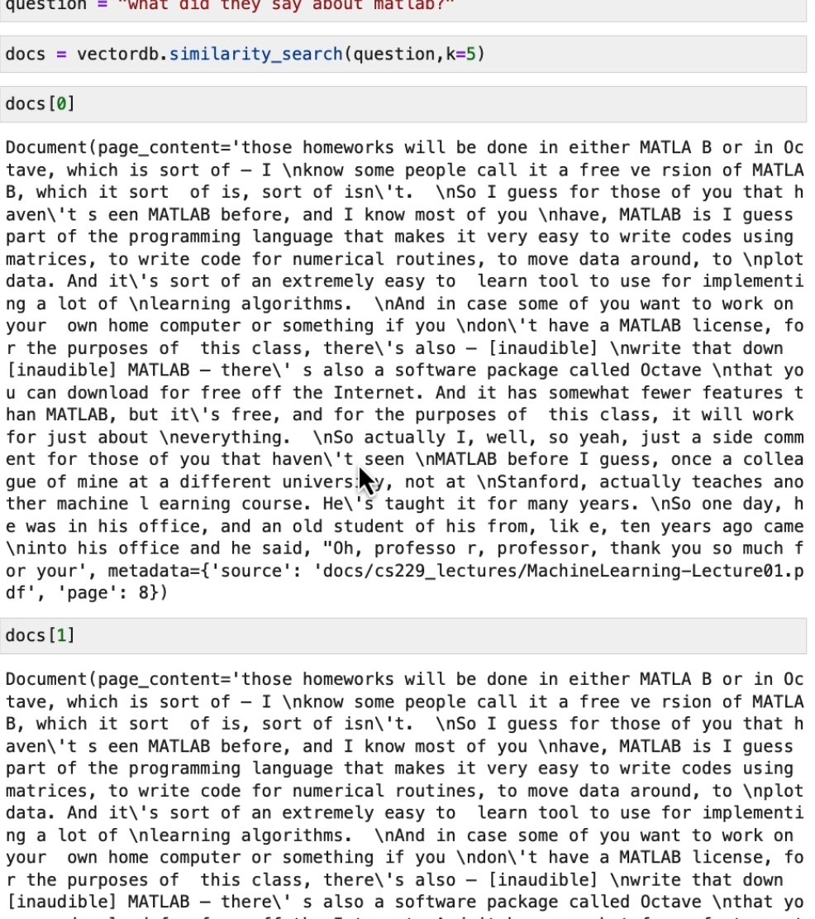
Two same answers because 2 same documents were loaded, and 2 chunks were returned.

Slide 29
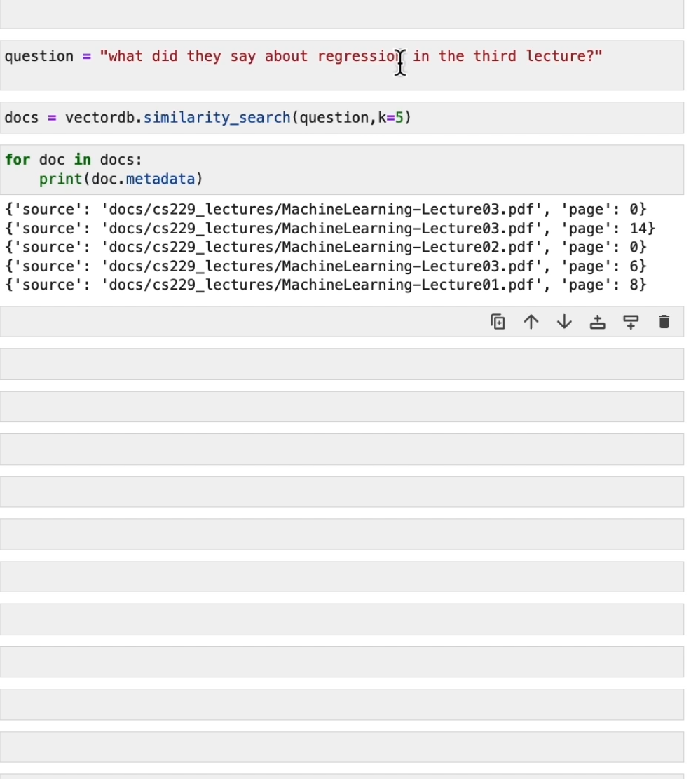
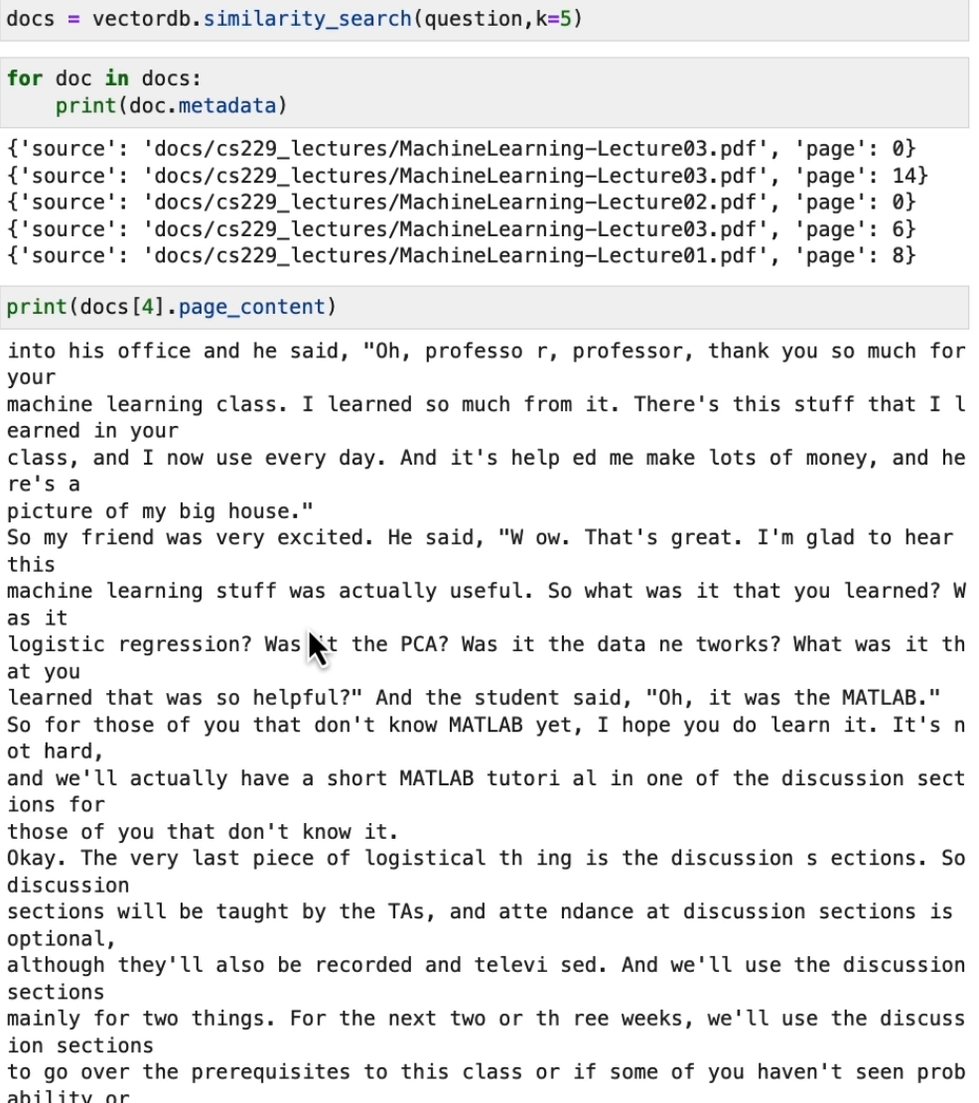

Slide 30
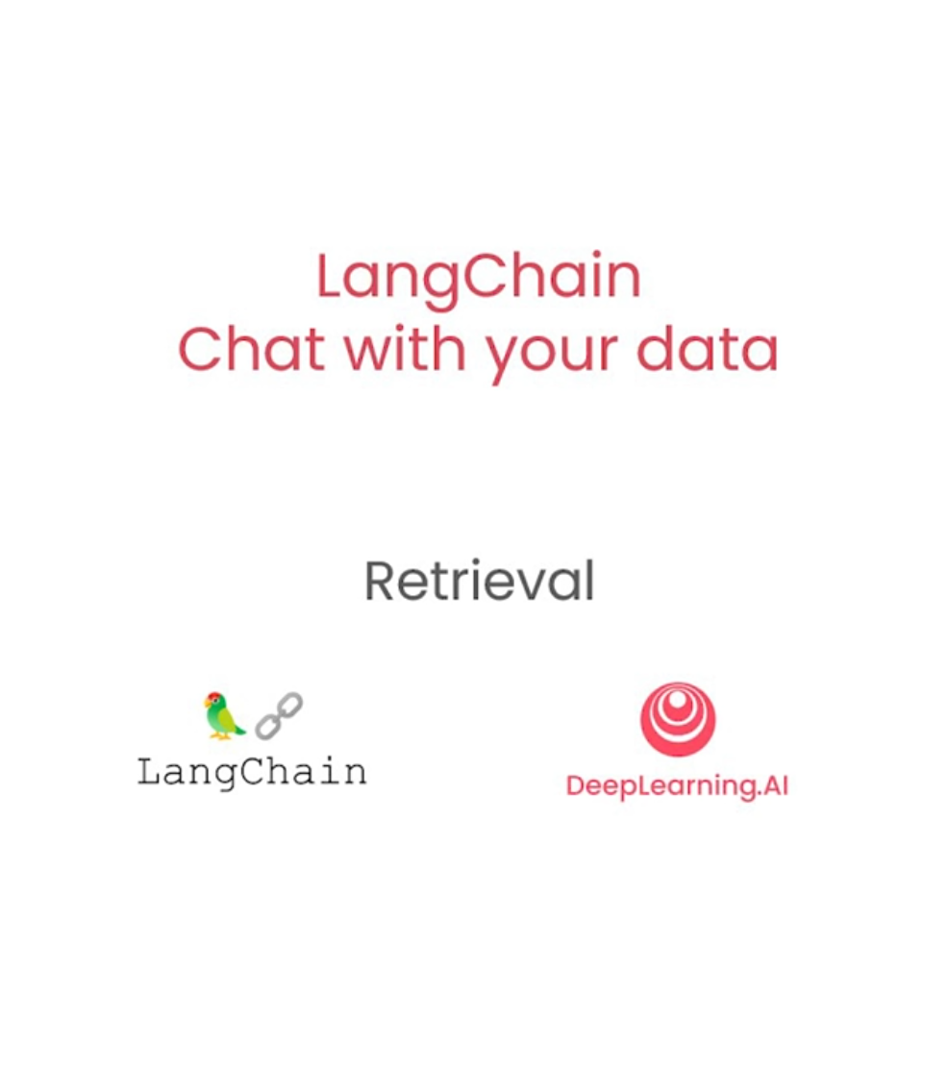

Slide 31
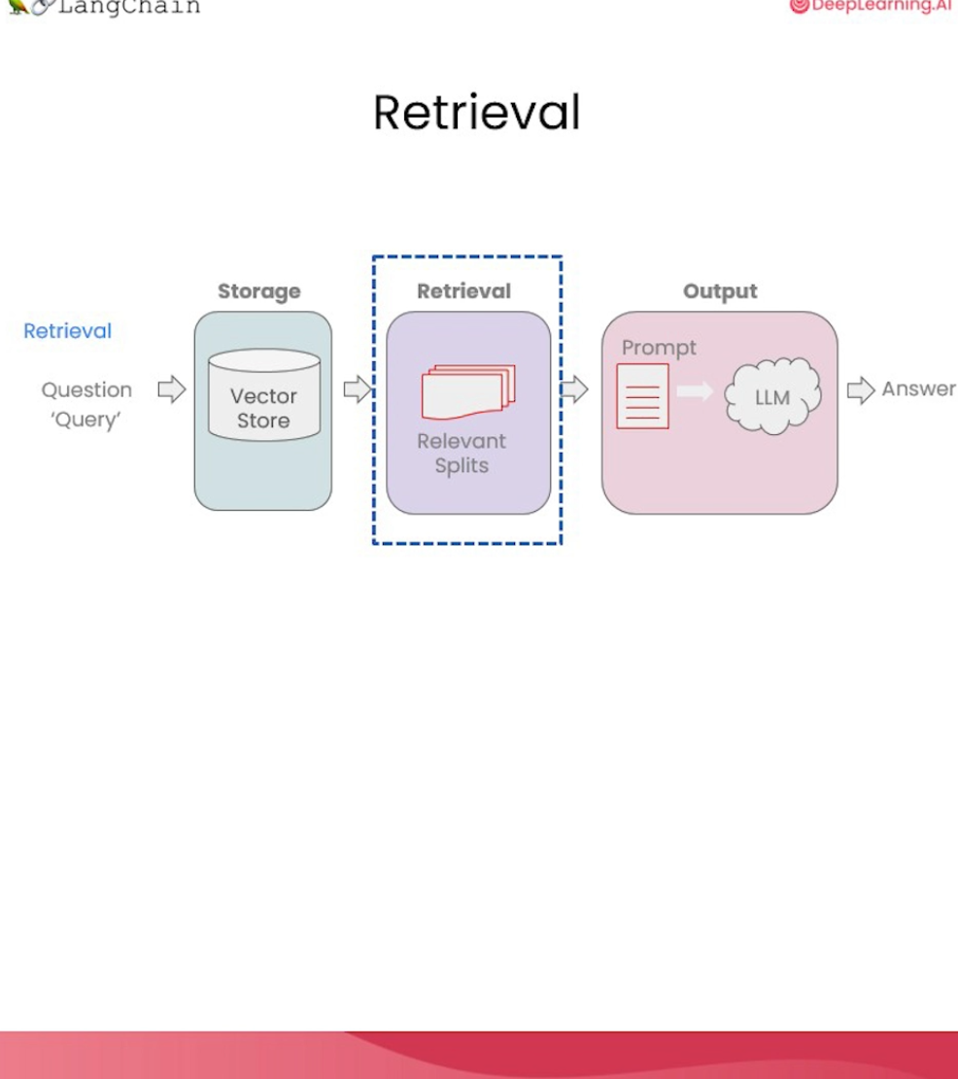
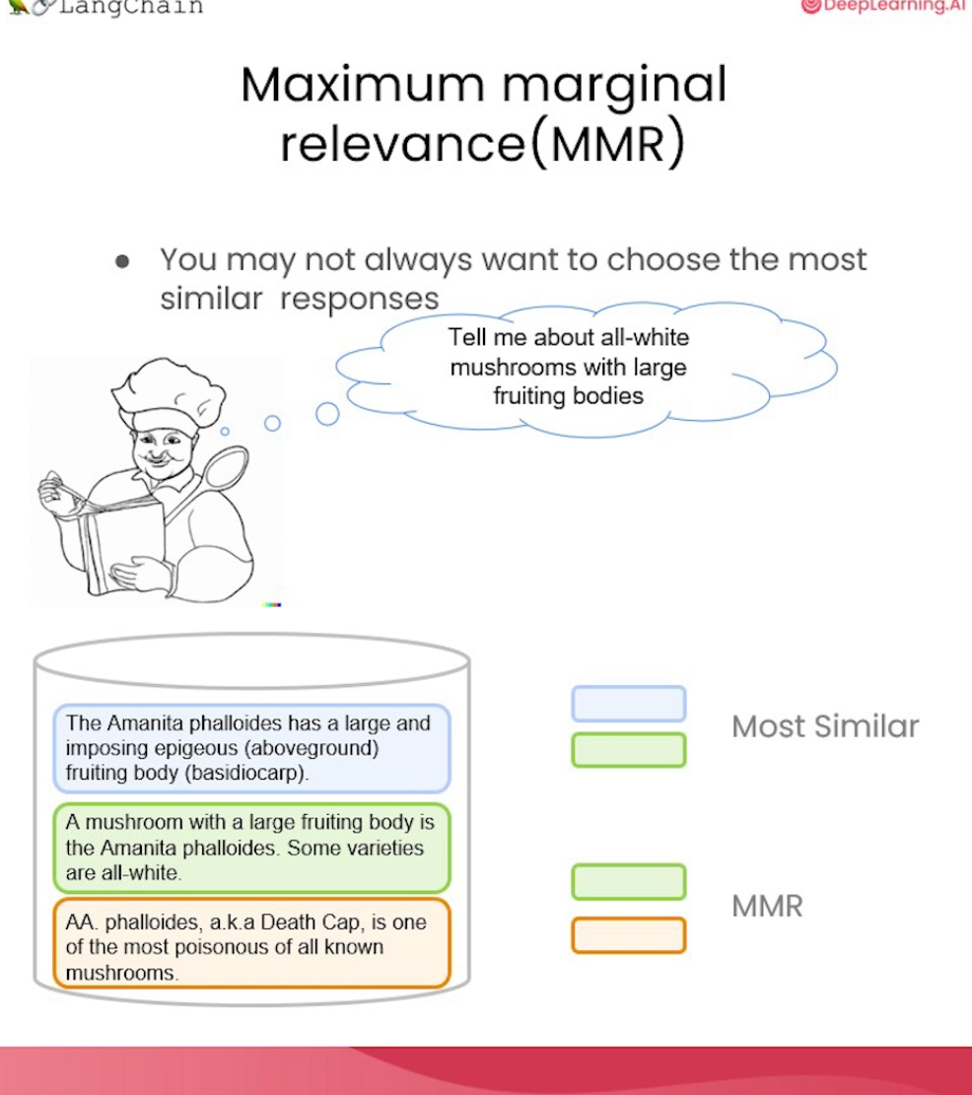

Slide 32
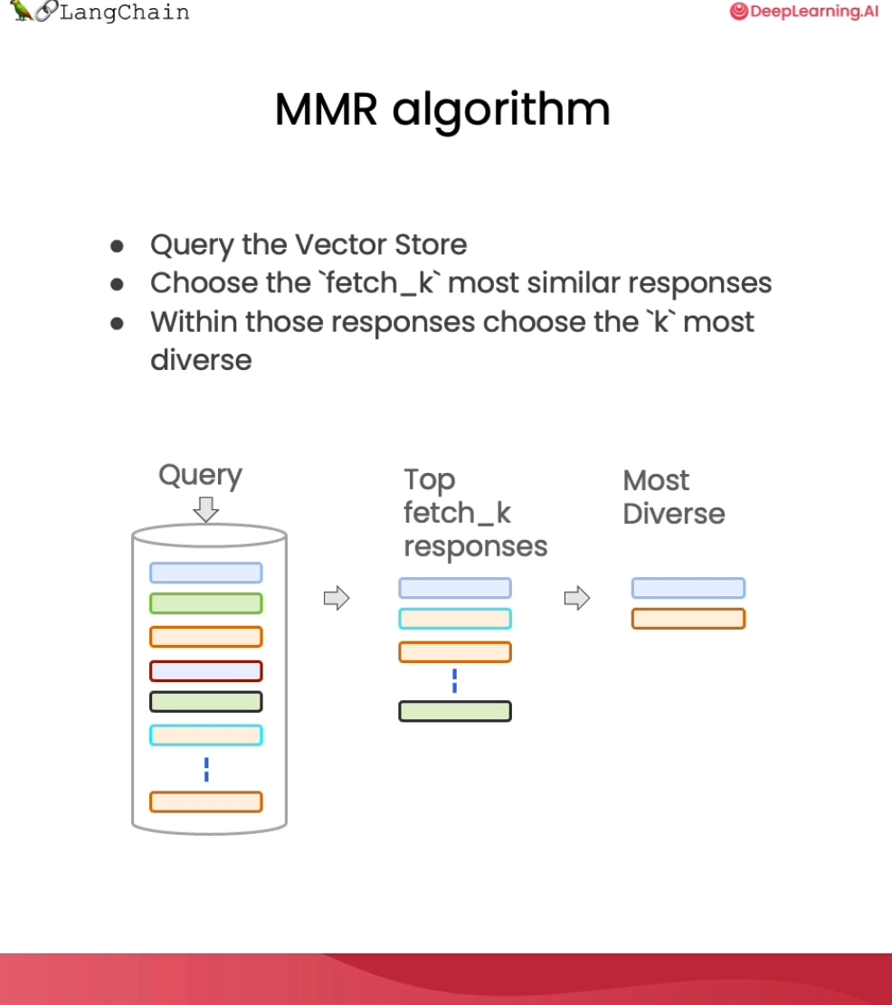
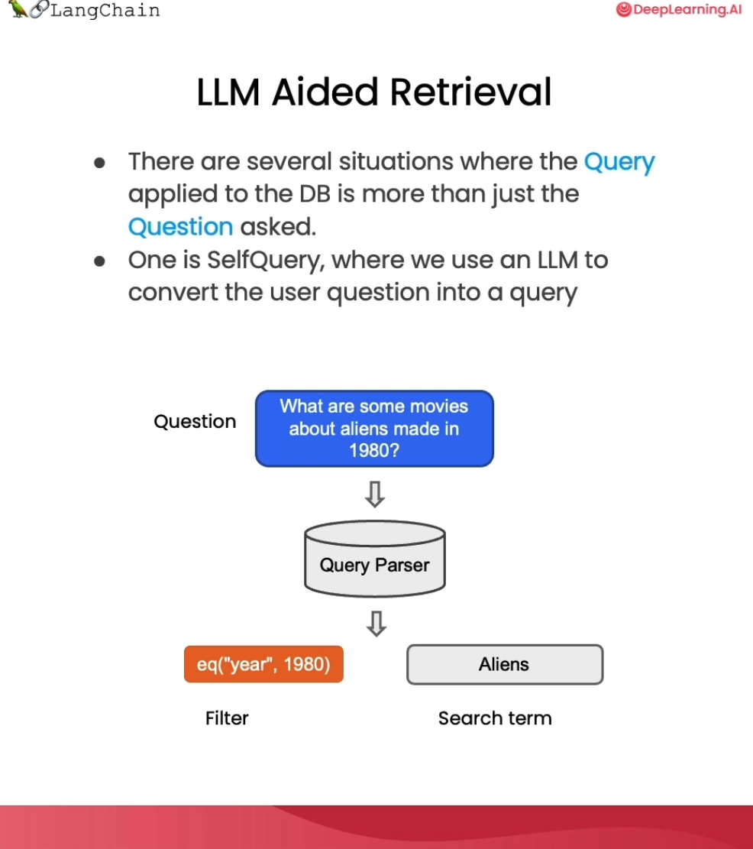

Slide 33
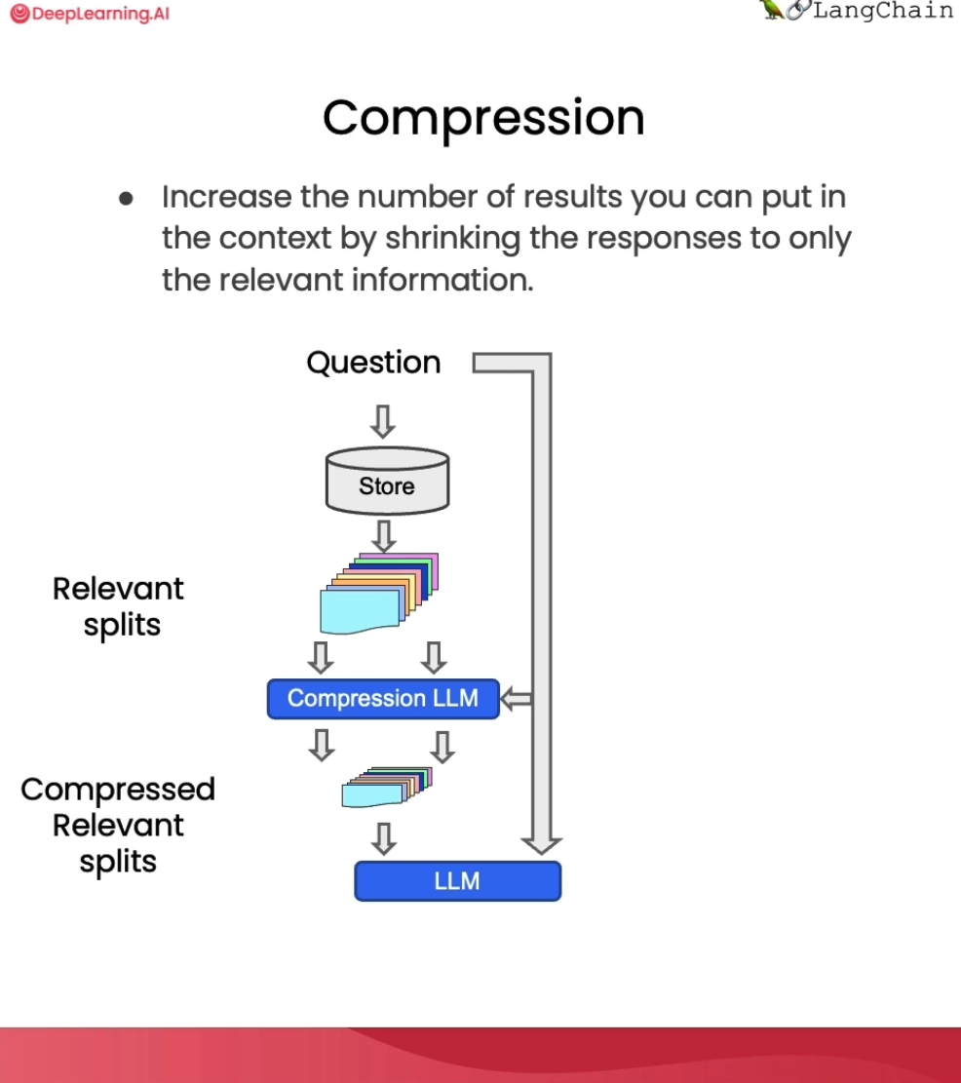

Slide 34
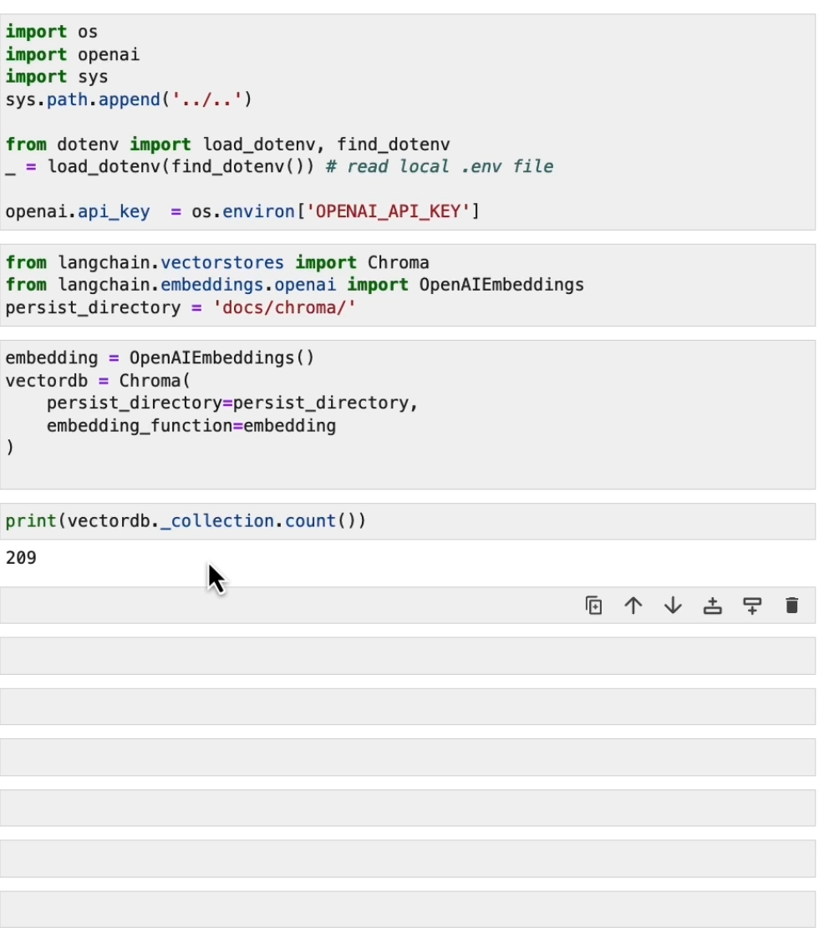
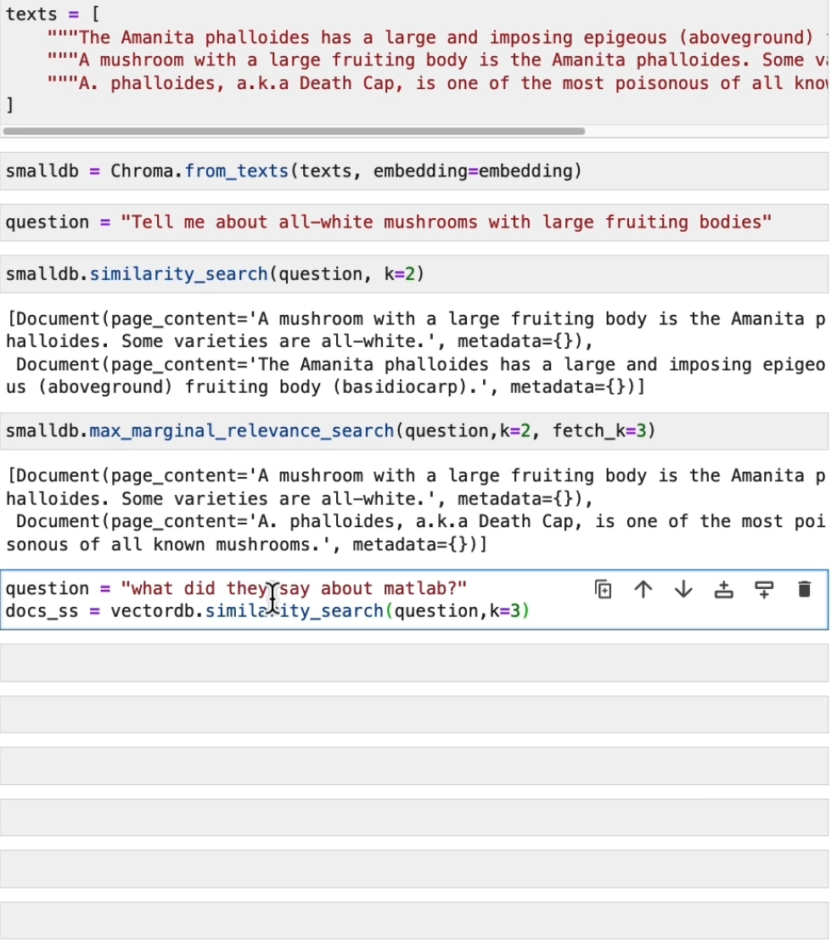

Slide 35
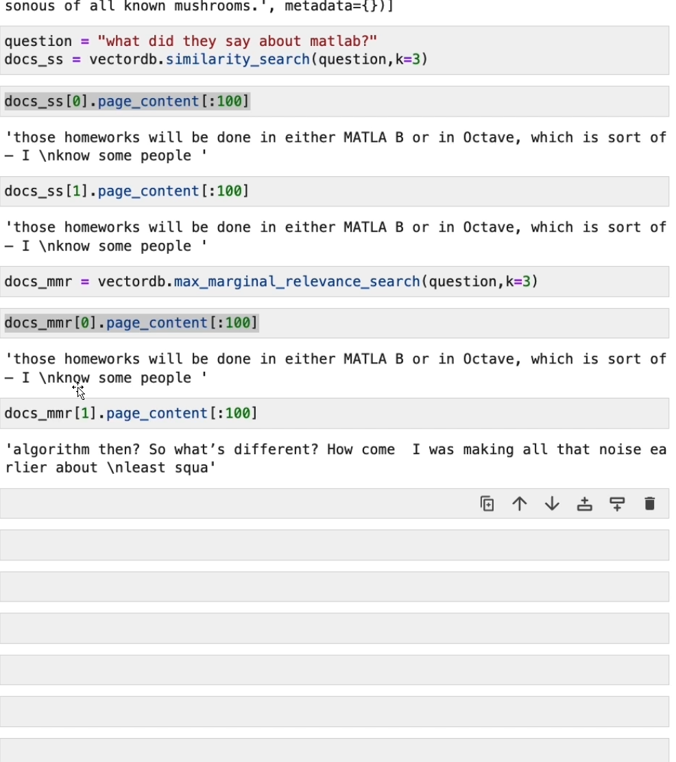
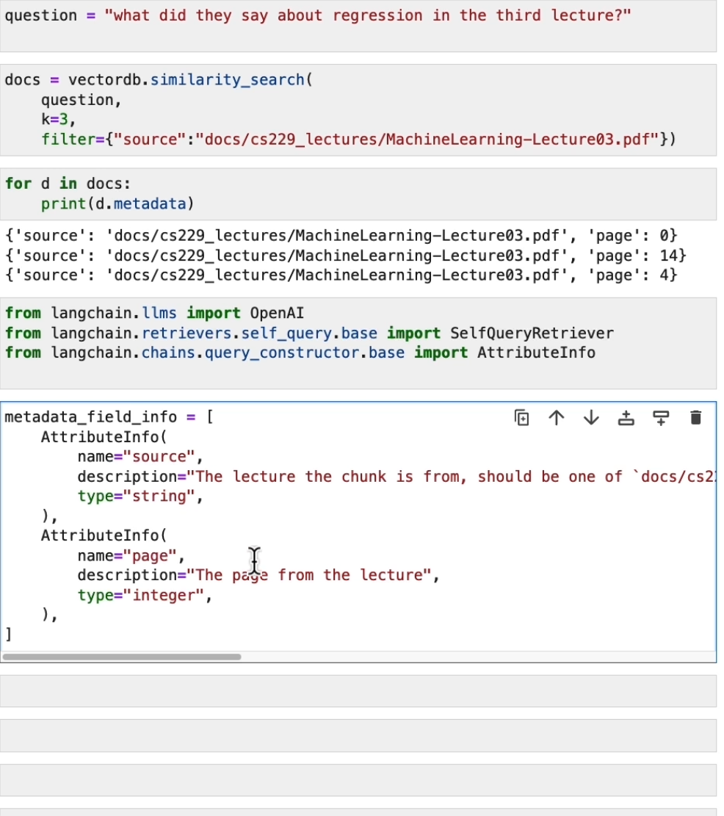

Manually defined source
LLM auto defined source
Metadata info for source and page is defined

Slide 36
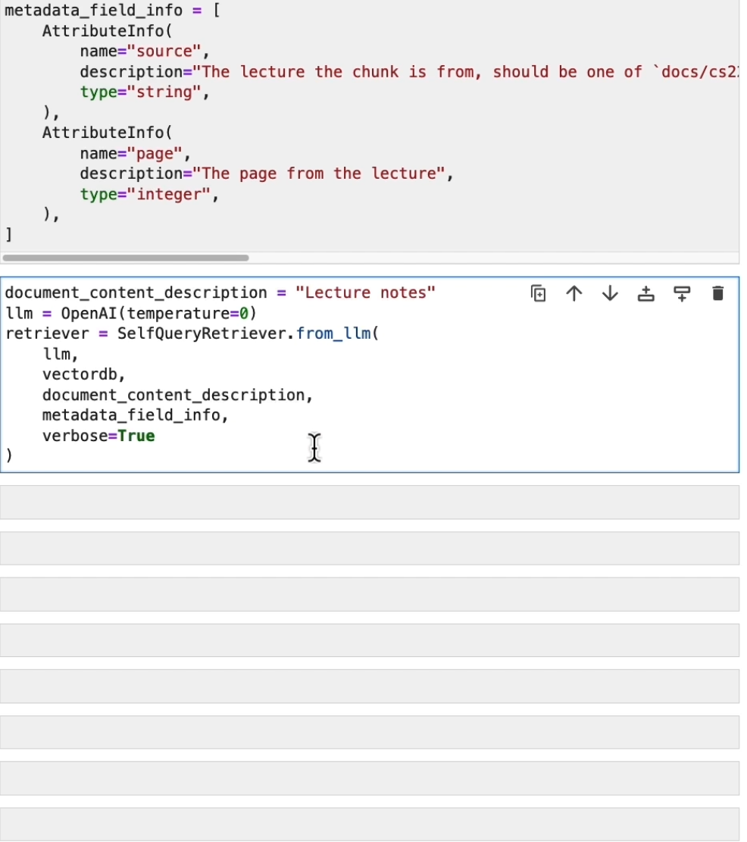
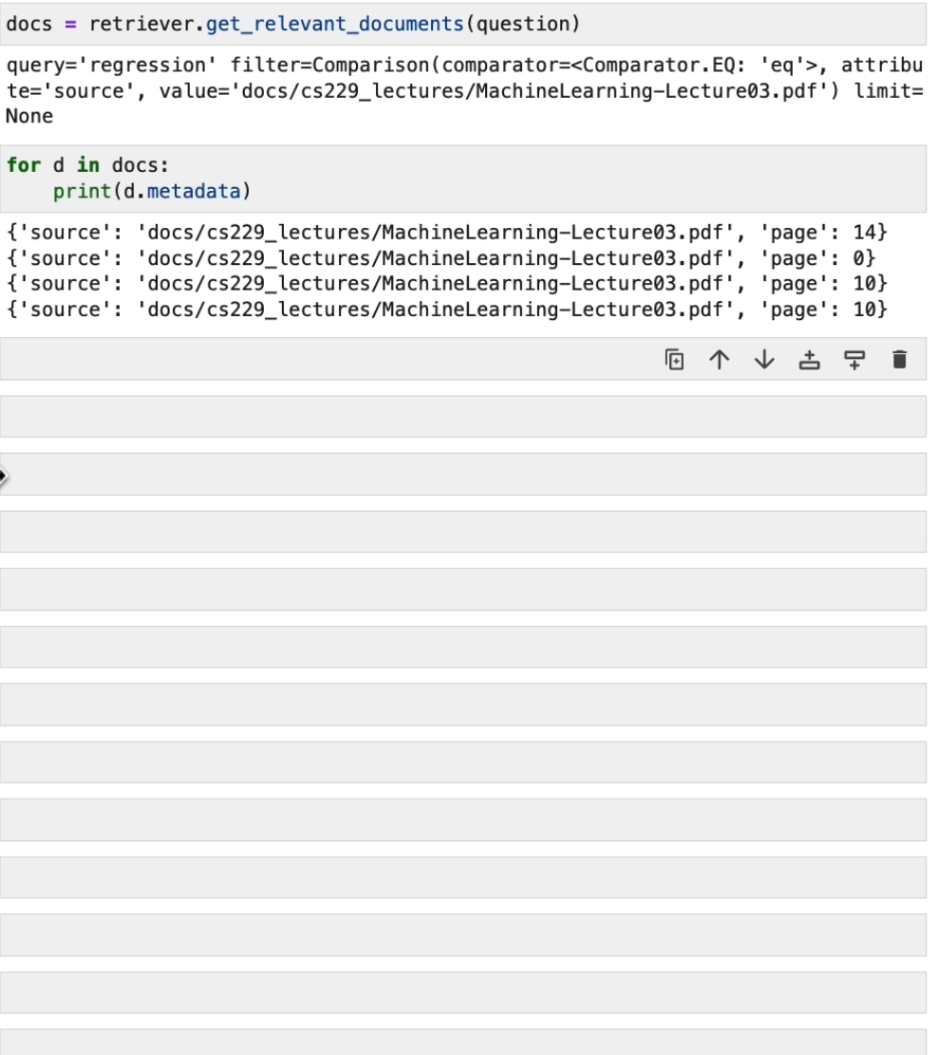
Self query retrieval shows from which documents the answer is produced
Self query retrieval defines the source and page that we want to search and return, it will be done by LLM

Slide 37
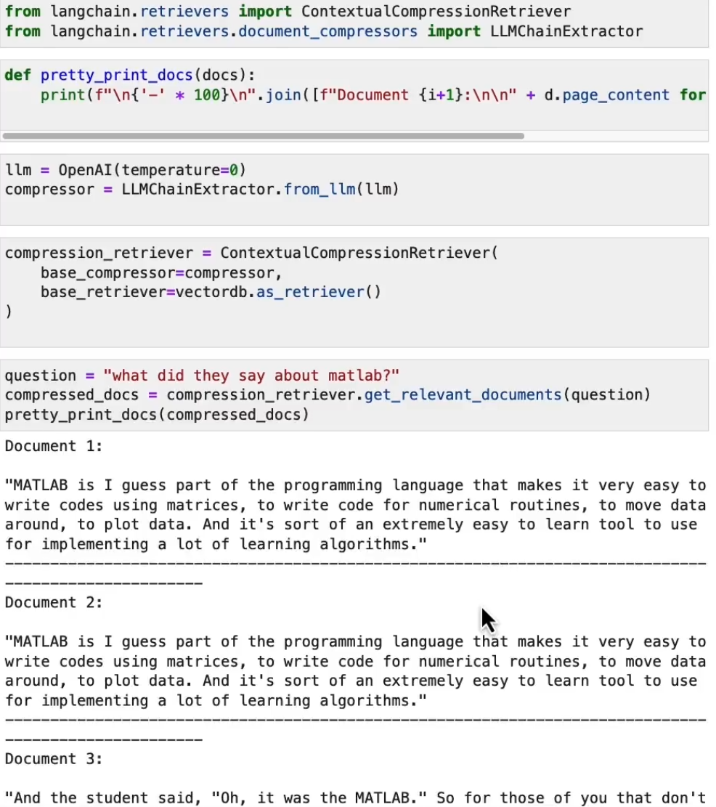
ContextualCompressionRetrival compress answers from all documents. LLMChainExtractor will return only relevant parts of document
We got shorter documents, but it can be repeated

Slide 38
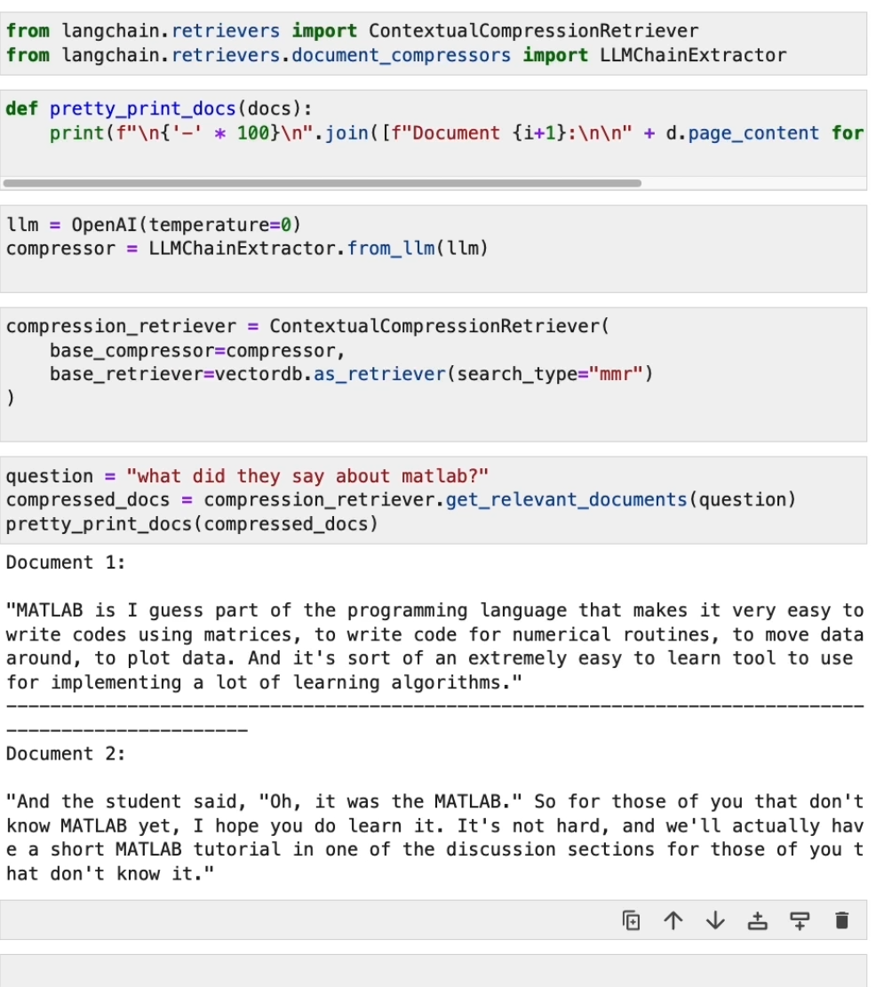
With MMR we will not get duplicate documents

Slide 39




Support Vector Machine retrieval, term frequency–inverse document frequency, is a measure of importance of a word to a document in a collection or corpus, adjusted for the fact that some words appear more frequently in general.

Slide 40



Slide 41


Slide 42



Slide 43

Multiple methods to use to tackle issue of short context window

Slide 44


Temperature 0 for lowest variability.
Import the RetriavalQA chain to send result chunks to LLM for answer

Slide 45



Slide 46

It can take multiple documents
It takes a lot slower
Response is even worse, it’s responding based on different documents, context is distributed over multiple documents

Slide 47

Check with LangSmith what is happening with map reduce

Slide 48

Refine retrieval method gives better results than map reduce because it combines information sequentially and takeovers more information than map reduce

Slide 49

Not a good answer as the CHAIN does not have a memory what was a previous question or answer

Slide 50


Slide 51

Chat history will give context from previous answers/question and continue the conversation with followup.

Slide 52

All types of retrival can be used.

Slide 53



Slide 54

New chain type -> conversation retrival chain, adds memory, takes history and the new question and condenses into stand-alone question to pass to the vector store to look up for relevant documents.
Follow up question on previous answer.

Slide 55


1. Call to llm

Slide 56



Slide 57



Slide 58
Create a chatbot that works on your documents

Slide 59



Slide 60


